Slide 1
If the medium is digital, what is the message?
Dr Ross Tapsell
College of Asia and the Pacific
The Australian National University
Email ross.tapsell@anu.edu.au T: @rosstapsell

Slide 2
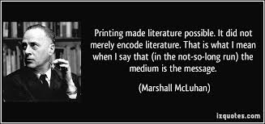
The medium is the message

Slide 4
Newspapers and the nation-state

Slide 6
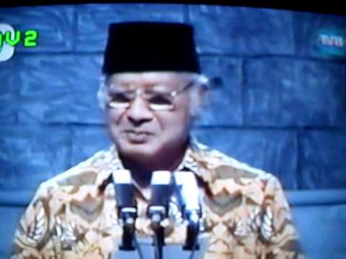
Television and authoritarianism

Slide 7
https://www.youtube.com/watch?v=PzlbkiVyHss

Slide 8
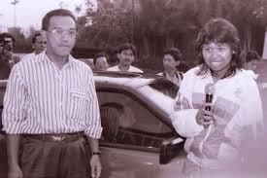
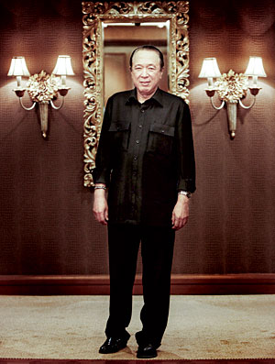
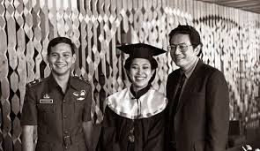
The Satellite and oligarchy

Slide 9
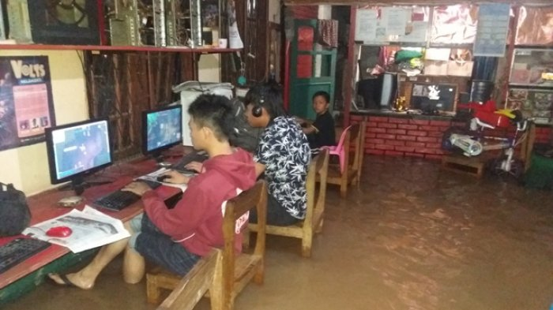
Internet and democracy

Slide 10
https://www.youtube.com/watch?v=Be2w8zr_AVQ

Slide 11
If the new medium is digital, what is the message?

Slide 12
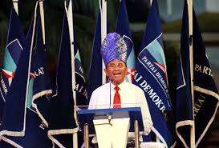
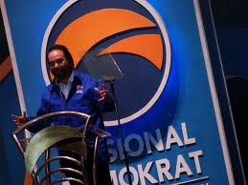
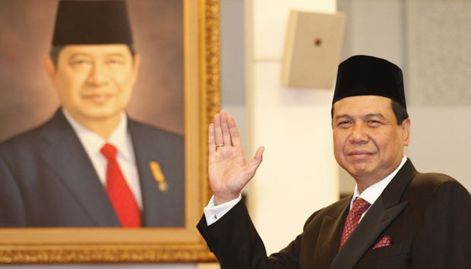
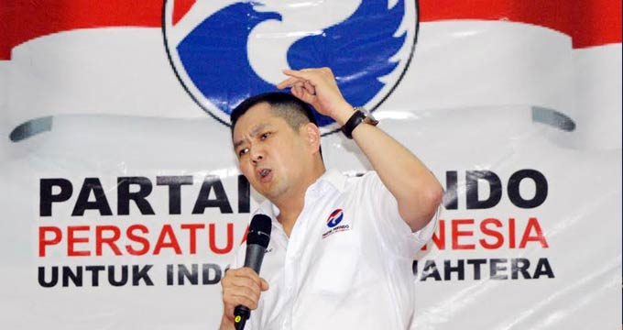
1. Digitalisation enables greater concentration of elite power.

Slide 13
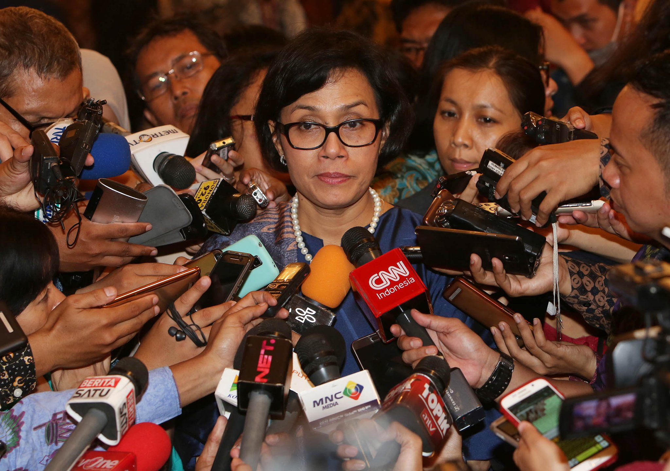

Slide 14
https://www.youtube.com/watch?v=Tl590qvdt5I

Slide 15
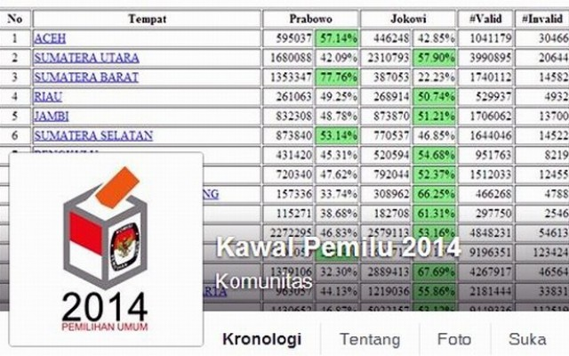
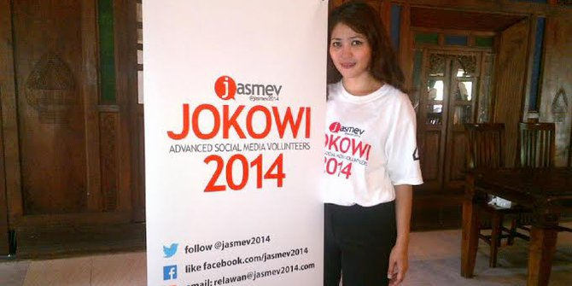
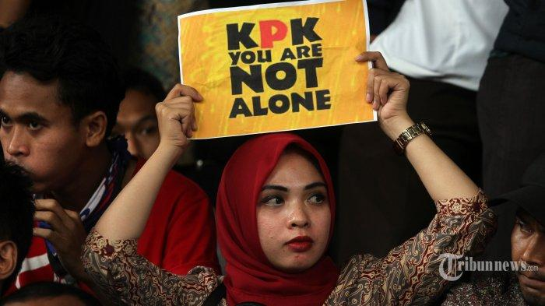
2. Digital media enables a more participatory society, and can counter ruling elite.

Slide 17
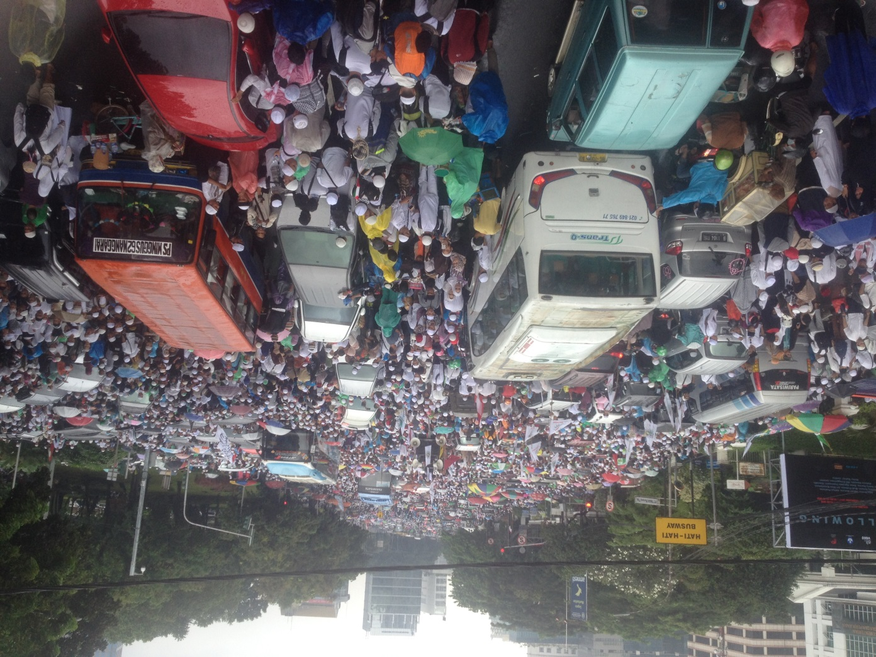
3. Participatory media leads to sectarianism? Politicians establish an emotive base via social media ‘echo chambers’, targeted algorithms and ‘filter bubbles’.

Slide 19
So, if the medium is digital, what is the message?
Q&A

Slide 21
Q: your media landscape
INDICATOR | 2003 | 2006 | 2009
1. 10 years old > who listen to radio | 50.29 | 40.26 | 23.50
2. 10 years old> above who watch TV | 84.94 | 85.86 | 90.27
3. 10 years old > who reads newspapers/magazines | 23.70 | 23.46 | 18.94
.

Slide 22
Company | Media subsidiary | Owner | TV stations | Flagship print & radio | Online | Key comms Infrastructure company
CT Corp | TransCorp | Chairul Tanjung | TransTV Trans7 CNN |  | Detik CNN | Transvision cable company
MNC | MNC | Hary Tanoesoedibyo | MNC GlobalTV RCTI* | Koran Sindo: TrijayaFM; Radio Dandut; ARH Global radio | Okezone Sindonews | ESBEN satellite; Indovision; Play media
EMTEK | SCTV Group | Eddy Sariaatmatja | SCTV Indosiar | El Shinta | Liputan6 | NEXT media
Lippo | BeritaSatu | James Riady | BeritaSatu | The Jakarta Globe; Suara Pembaruan | Beritasatu.com | LinkNET; First Media;
Kompas Gramedia | Kompas Group | Jacob Utama | KompasTV | Kompas; Sonora Radio & otomotion radio | Kompas.com Tribunenews.com | K-vision
Bakrie Group | Visimedia Asia | Aburizal Bakrie | TVOne ANTV Bloomberg |  | Viva News | VivaSKY; Barkie Telcom
Jawa Pos Group | Jawa Pos Group | Dahlan Iskan | JawaPosTV | Jawa Pos; Fajar FM (Makassar) | jpnn.co.id | Fangbian Iskan Corporindo
Media Group | Media Indonesia Corp | Surya Paloh | MetroTV | Media Indonesia | Metrotvnews.co
Media Indonesia Corp | Media Indonesia | Surya Paloh | MetroTV | Media Indonesia | Metrotv.com

Slide 23
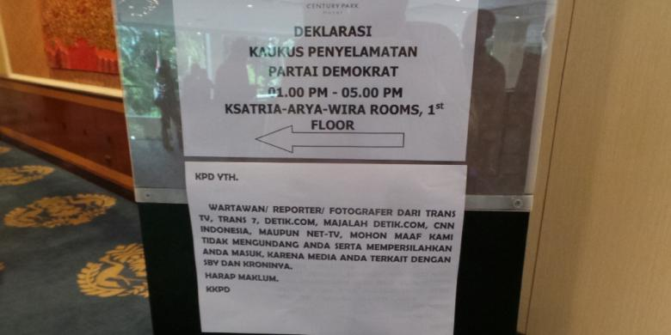

Slide 24
A Fourth Industrial revolution: IoT

Slide 25
The Sawito trial

Slide 26
A key difference..

Slide 27
Shifting information society

Slide 28
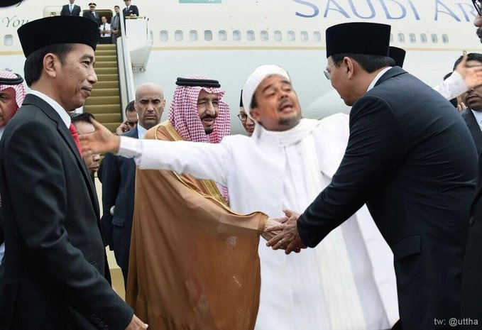
Indonesia: medium and change
Dr Ross Tapsell
College of Asia and the Pacific
The Australian National University

Slide 30
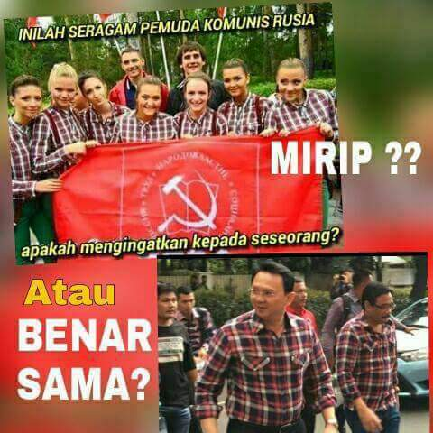
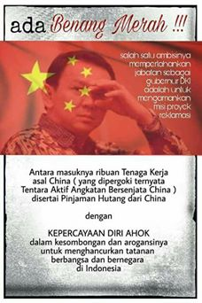
Bringing down Ahok’s popularity
That Ahok has been an effective governor was not in question in this election. His approval rating as governor is around 75%.
15% have watched the Ahok ‘blasphemy’ video, while 57% think he’s guilty.

Slide 31
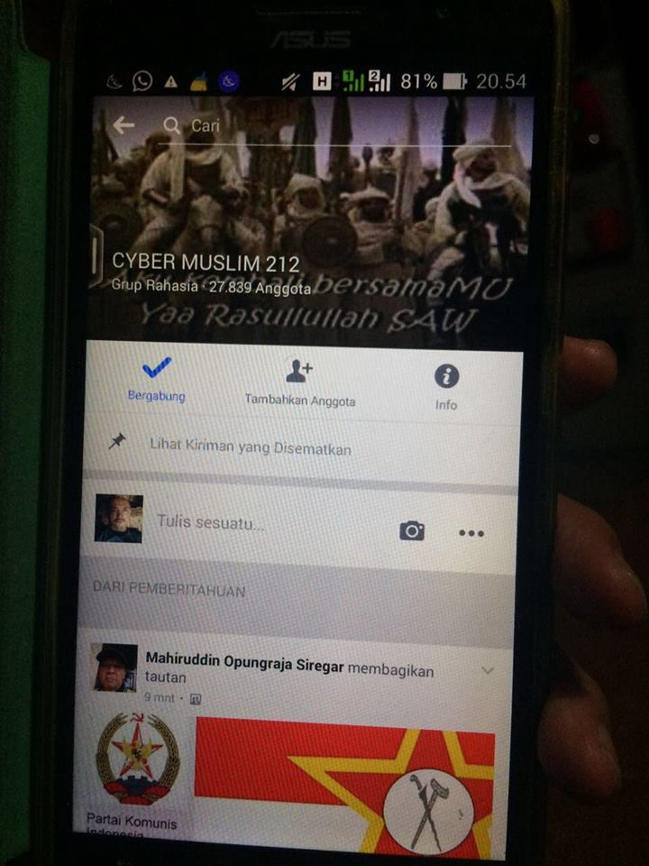
Emotions over facts (2)

Slide 32
Berikut ini adalah daftar media gurem yang kerap memposting artikel anti-cina:
tajukindonesia.net
garudakita.com
tribunislam.com
nahimunkar.com
pribumi.win
islamnews.com
umatuna.com
nasional.in
dakwahmedia.net
jurnalmuslim.com
republica.asia
up-islam.com
Teropongsenayan.com
Sangpencerah.id
nusantarakini.com
posmetro.co
tajukindonesia.net
bataranews.com
islampos.com
suaranews.com
duaniamuslim.com
berita.islamedia.id
mediapribumi.com
nusanews.org
repelita.com
eramuslim.com
beritaislam24h.net
Kanalberita8.co
Portalpiyungan.com
Panjimas.com
bersamadakwah.net
Kiblat.net
Kabarsatunews.com
Intelijen.com
Dimedan.co
Islamsehat.ml
Mediankri.net
Kabarmakkah.com
Seulawahnews.com
Cendananews.com
kumpulankonsultasi.com

Slide 33
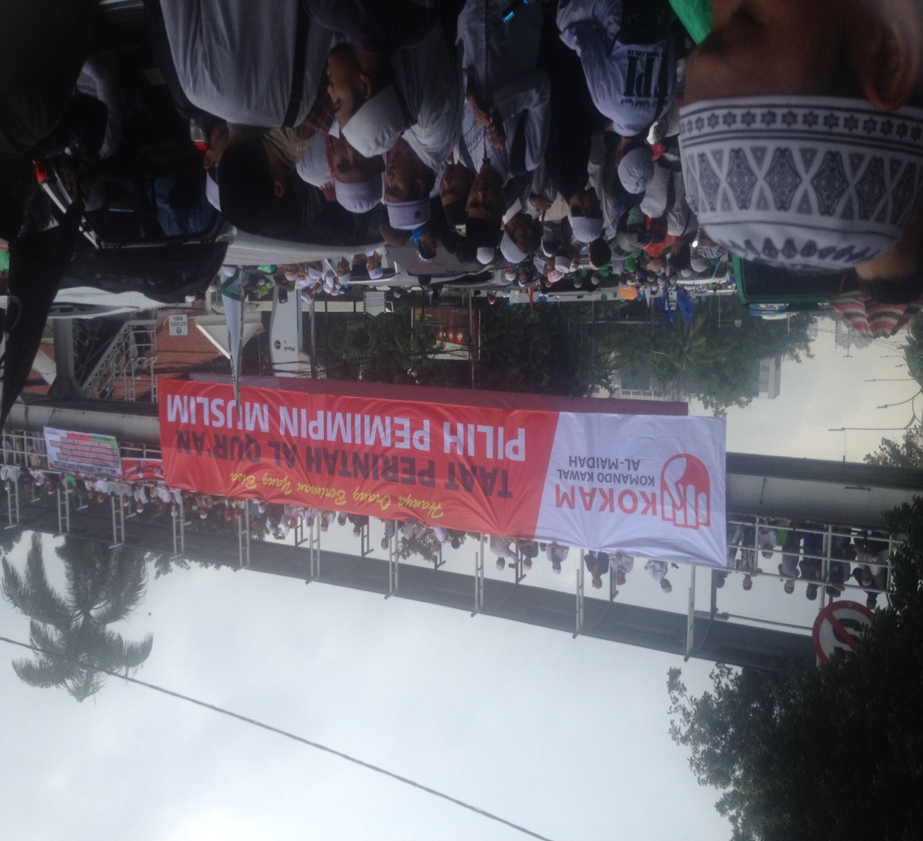

Slide 34
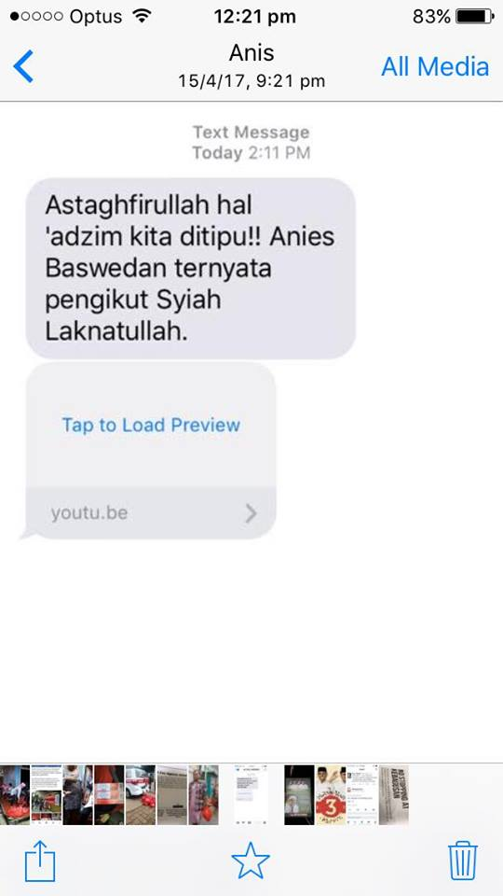

Slide 35
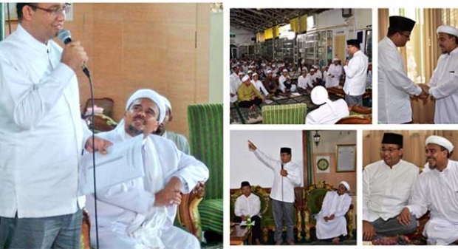

Slide 36
“This is an essential book that explores the relationship between the Indonesian media, especially in digital form, and oligarchy on the one hand, and civil society on the other.” Vedi Hadiz

Slide 37
So, what is the solution?
Digital literacy programs in high school education to address culture of sharing
Increased internet speeds and access beyond 2G
Credible civil defamation laws, sensible police prosecution (UU ITE is not working).
Blasphemy and pornography laws, when the internet is involved, become more politicized. Abolish both laws.
A more credible public service media. Merge TVRI, RRI and Antara into one well-funded news site. Hire staff from private sector. Sack the New Order dinosaurs.
Find online spaces/platforms for open, transparent, ‘counter-oligarchic’ digital media, and credible professional media that looks to find solutions to rising inequality.

Slide 38
Is the internet being ‘weaponised’?
Scholars around the world are increasingly concerned with the way in which social media is being used to divide societies around sectarian issues. In short the Internet has become the bad guy.
What has been Indonesia’s response?
Governments, police, and political parties now have ‘anti-hoax’ units
Instagram is rising amongst youth. Twitter and Facebook declining. Does this tell us something?
Can digital media still be ‘counter-oligarchic’? Think Kawal Pemilu, Tabloid Jubi, Jokowi’s ascendency to power.

Slide 39
