Slide 1
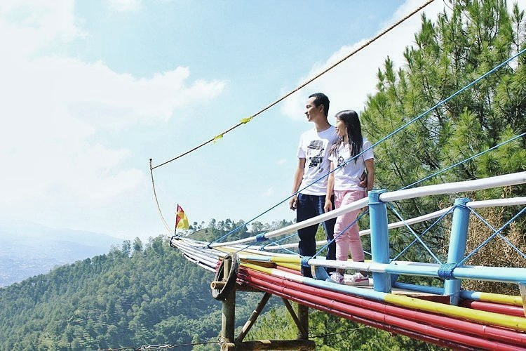
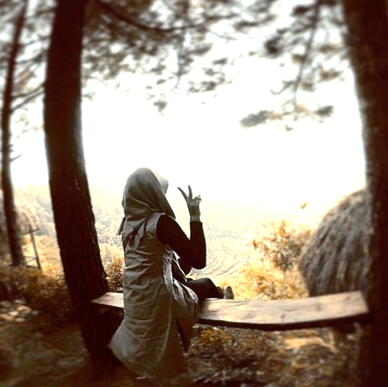
Social Media and Sustainability: Consuming Conservation in the Age of Instagram?
Dr. Meghan Downes
National University of Singapore / Monash University Australia

Slide 2
extreme weather
rising sea-levels
air/ water / soil pollution
“the great Pacific garbage patch”
mass extinctions
deforestation
micro-plastics
food waste & food security
climate change
melting glaciers

Slide 3
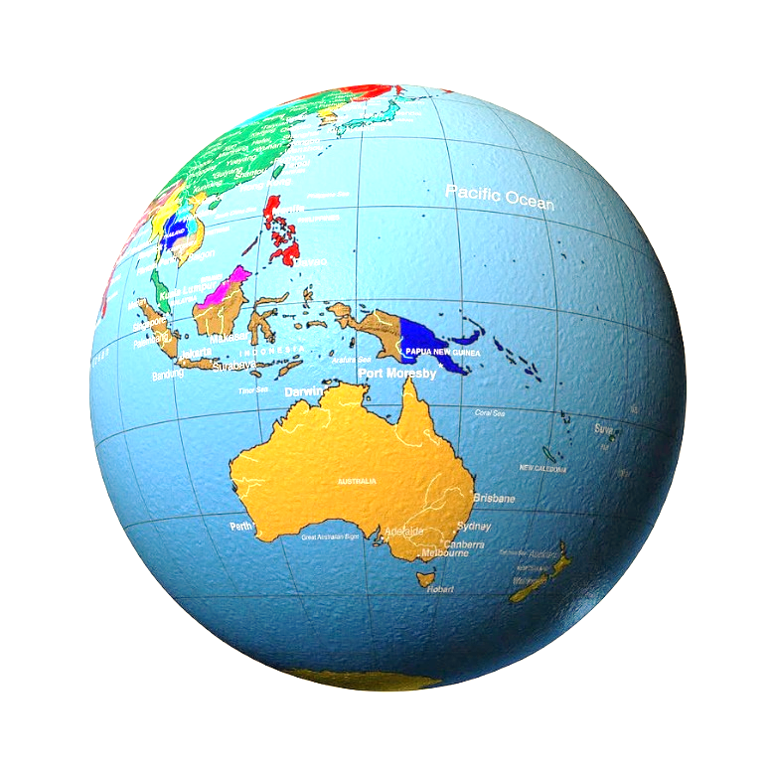
social
media
environmental
Justice
young
people
My own projects
Current research on social media & civic engagement
Examples: Indonesia Singapore
Audience perspectives

Slide 4
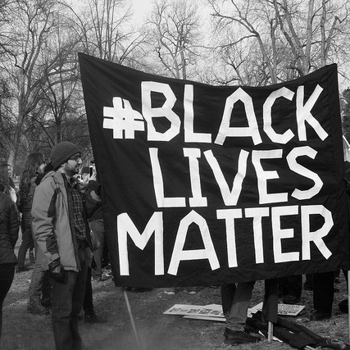
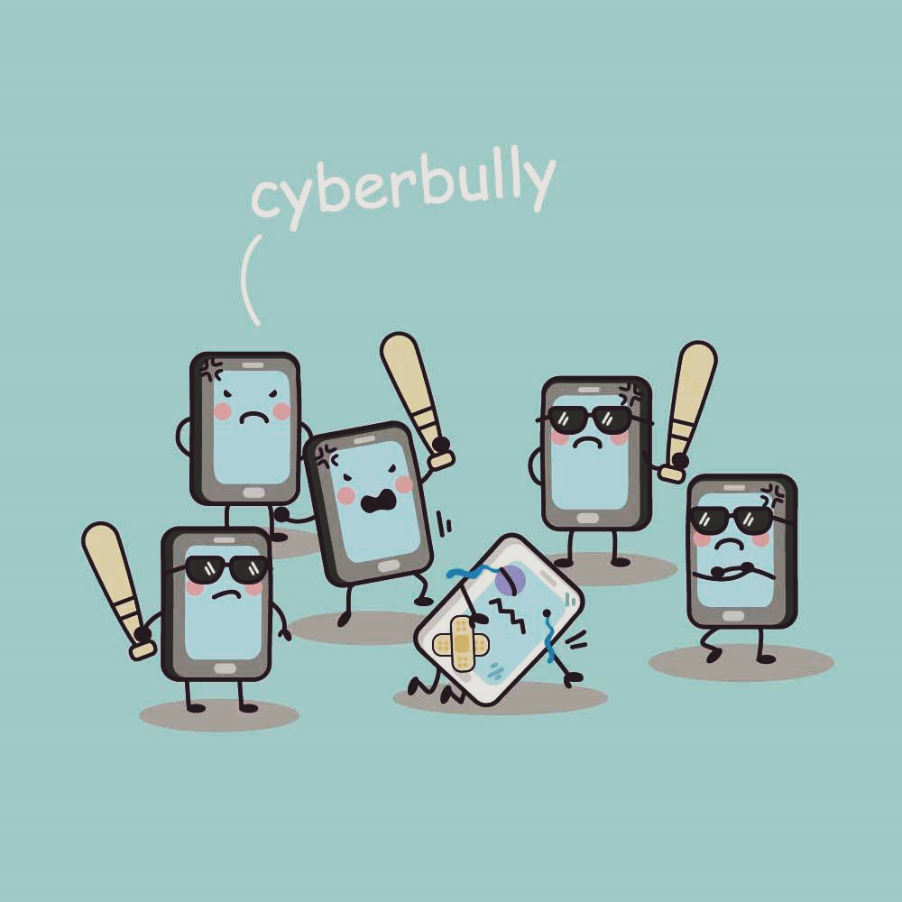
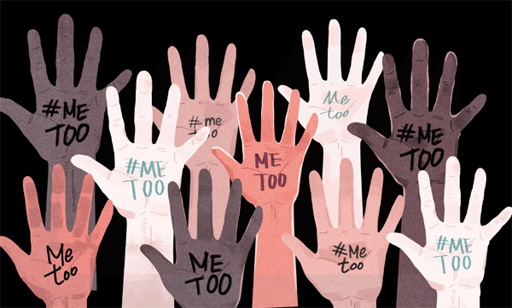
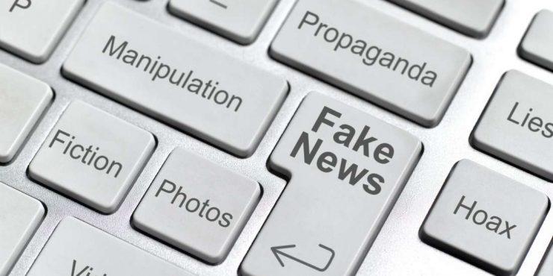
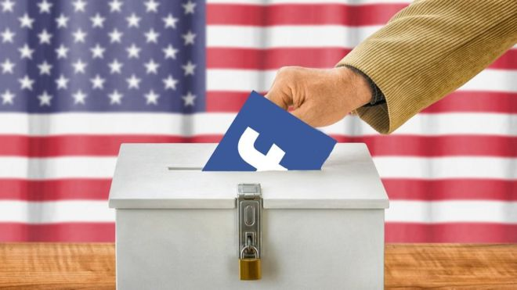

Slide 5
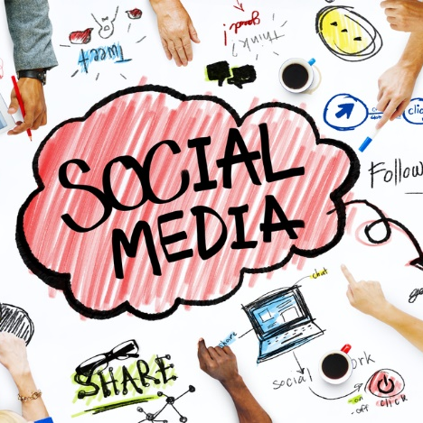
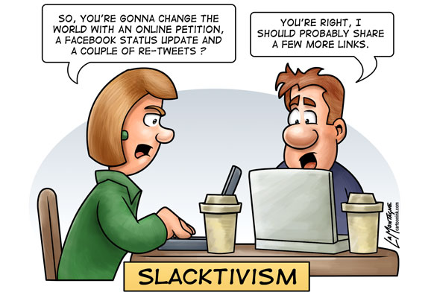
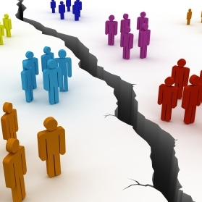
Three Perspectives
Major impact in promoting broad and effective participation and engagement
Mainly online ‘clicktivism’ with minimal effect on offline practices
No change, simply reproducing existing patterns of access/power/inequality

Slide 6
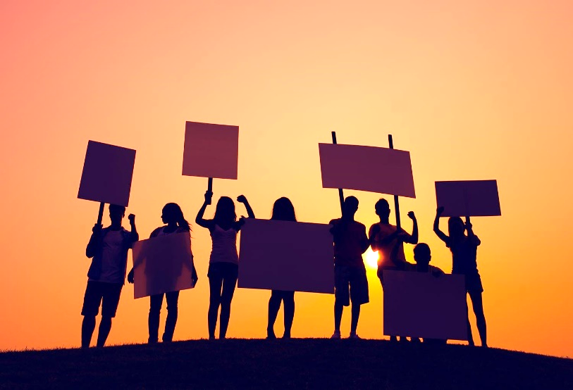
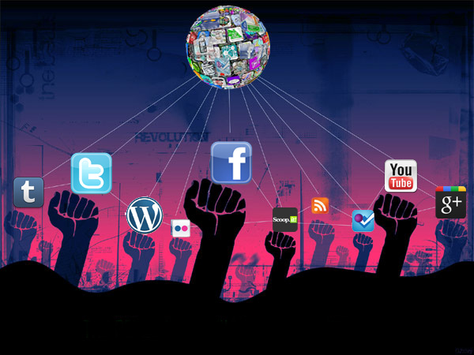
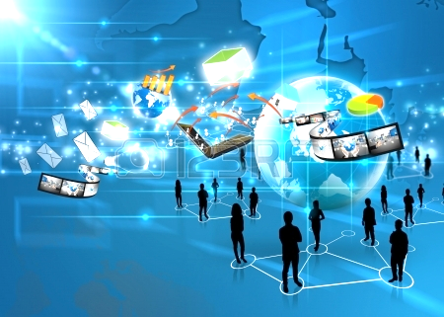
Major impact in promoting broad and effective participation and engagement
new spaces/voices/ideas = new and empowering forms of participation and “networked young citizens”
see: Bennett (2014), Burke & Sen (2018), Comunello et al. (2016), Cumberbatch & Trujillo-Pagan (2016), Holt et al. (2013), Johnson et al. (2011), Kahne et al. (2013), Levine (2011), Lievrouw (2011), Loader et al. (2014), Rheingold (2012), Segerberg & Bennett (2011), Tropiano (2016), Velasquez & LaRose (2014), Wessels (2014)

Slide 7
Three Perspectives
Major impact in promoting broad and effective participation and engagement
Mainly online ‘clicktivism’ with minimal effect on offline practices
No change, simply reproducing existing patterns of access/power/inequality

Slide 8
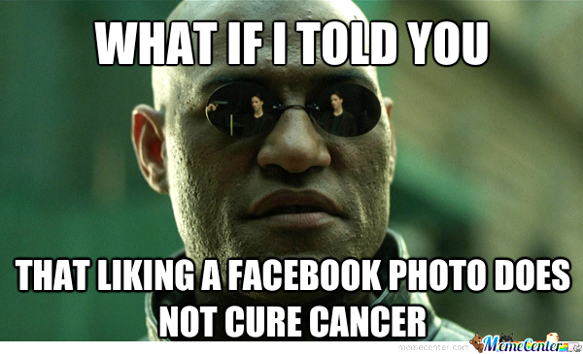
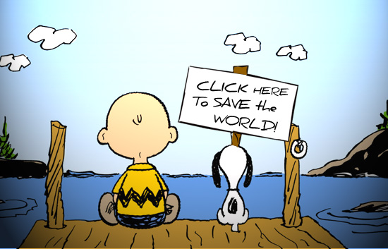
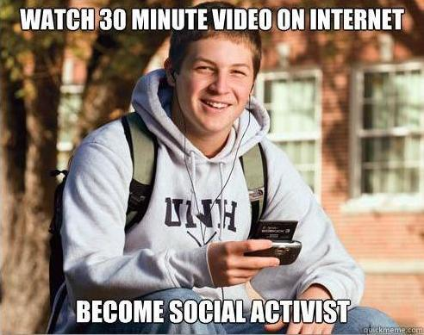
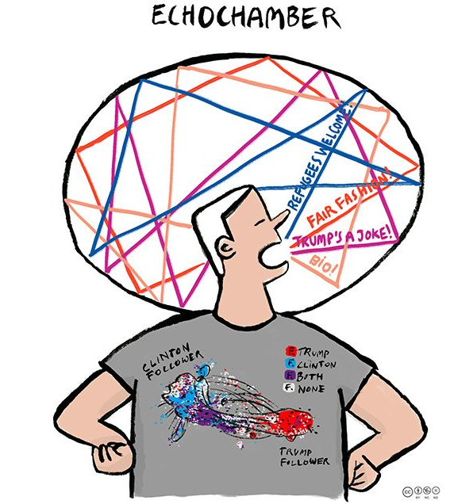
Mainly online ‘clicktivism’ with minimal effect on offline practices
low-risk, low cost, low-impact activities
see: Baumgartner & Morris (2009), Carlisle & Patton (2013), de Zuniga et al. (2012), Lee & Hsieh (2013), Leyva (2016), Morozov (2009), Ternes et al. (2014), Vissers & Stolle (2014), Vitak et al. (2011)
“filter bubbles” (Pariser 2011) “echo chambers” (Bessi et al. 2015)

Slide 9
Three Perspectives
Major impact in promoting broad and effective participation and engagement
Mainly online ‘clicktivism’ with minimal effect on offline practices
No change, simply reproducing existing patterns of access/power/inequality

Slide 10
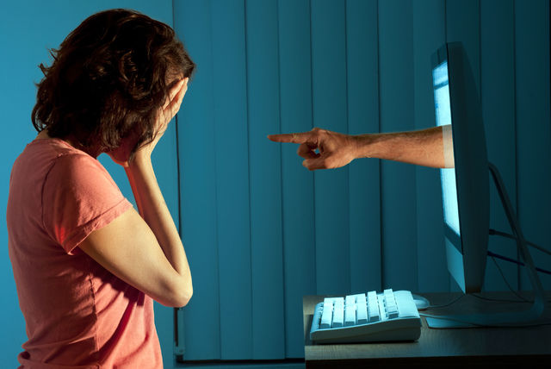
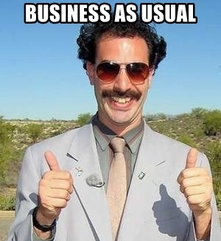
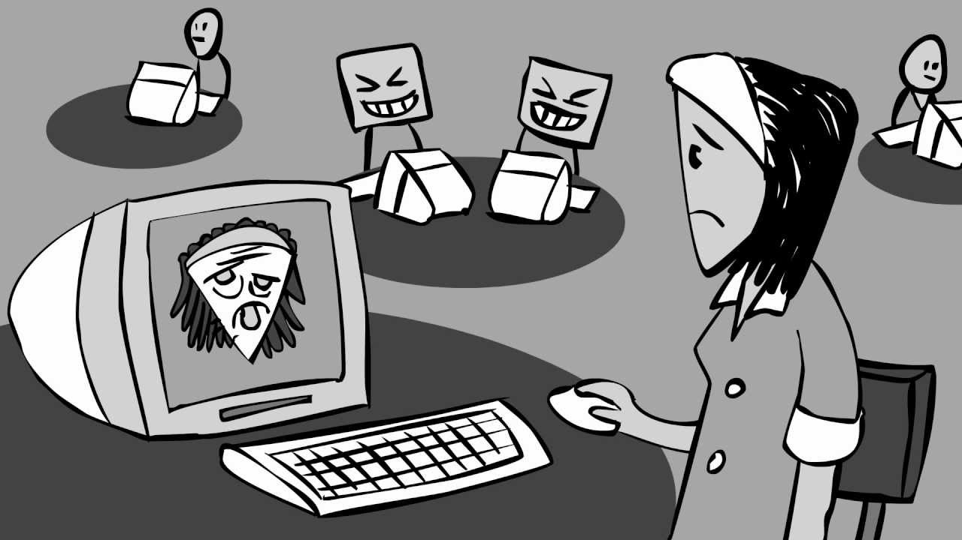
No change, simply reproducing existing patterns of access/power/inequality
“reinforcement hypothesis” and “the digital divide”
new tools for strengthening old patterns
see: Bakker & Vreese (2011), Hargittai & Shaw (2013), Locke et al. (2018), Marwick (2015), Theocharis & Quintelier (2016), Zhang et al. (2010)

Slide 11
Three Perspectives
Major impact in promoting broad and effective participation and engagement
Mainly online ‘clicktivism’ with minimal effect on offline practices
No change, simply reproducing existing patterns of access/power/inequality

Slide 12
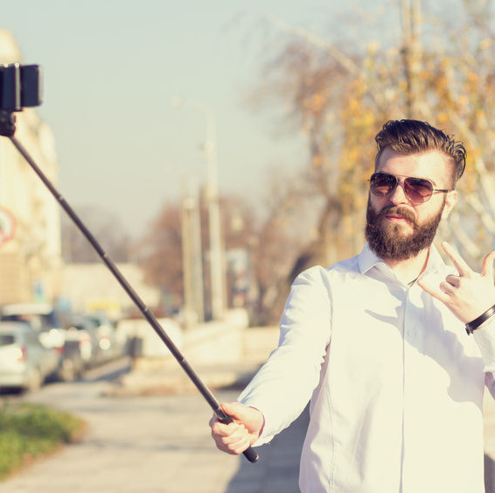
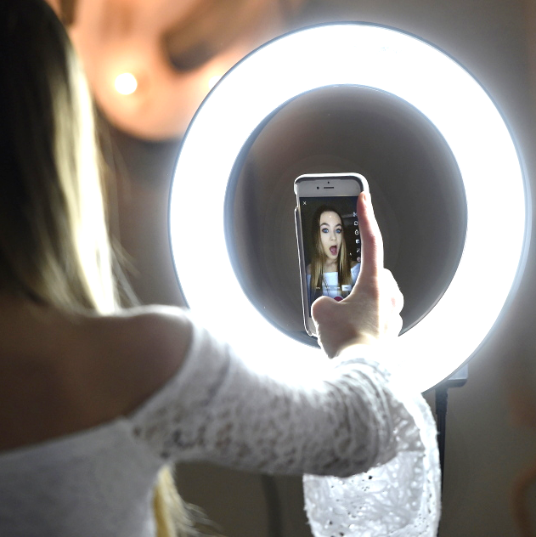
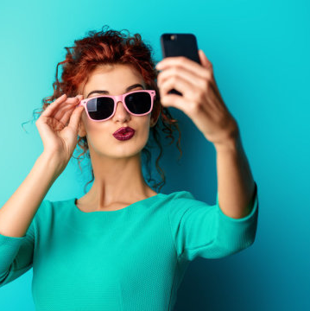
Selfies
an epidemic of narcissism among the young
(Twenge and Campbell 2009)
an empowering new self-presentation medium
(Lee 2005)
reproducing conventional status hierarchies of luxury, celebrity, beauty, and popularity
(Marwick 2015)
promoting post-feminist consumerism
(Duffy and Hund 2015)
making feminine labour visible via ‘subversive frivolity’
(Abidin 2016)
accessing the ‘hashtag economy’
(Solis 2011)

Slide 13
see: Baulch (2018)

Slide 14
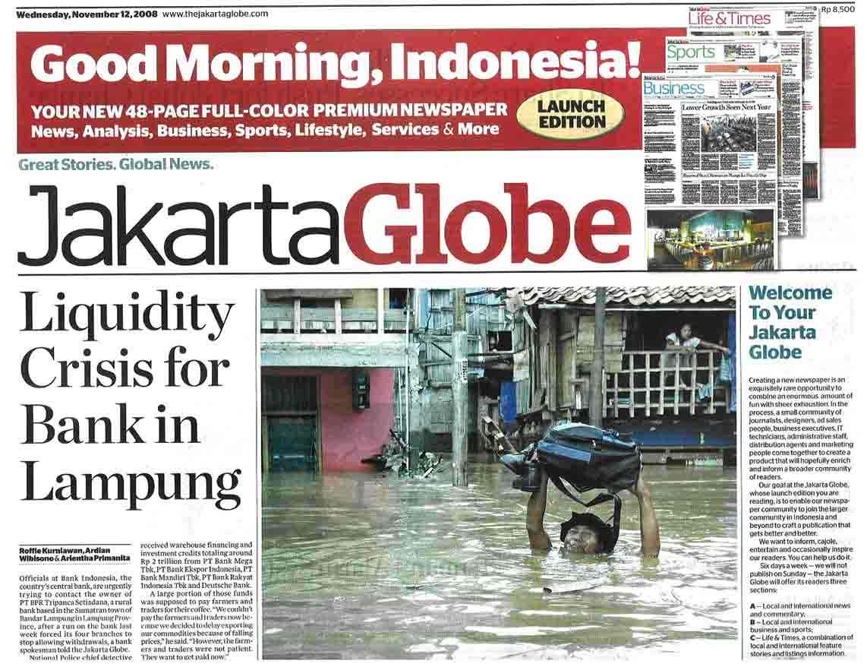
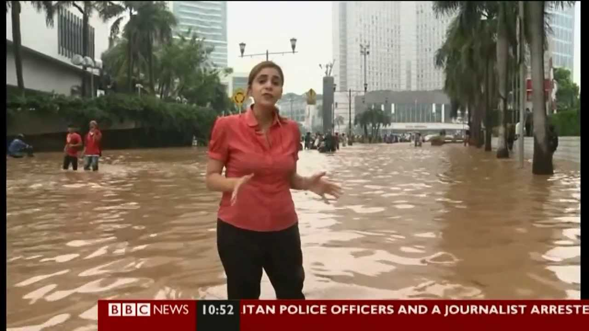
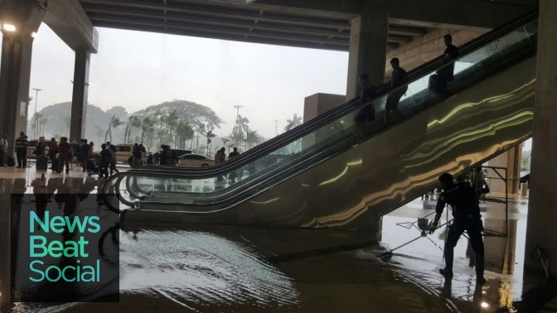
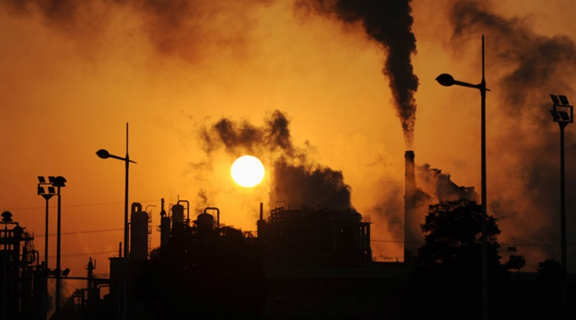
Environmental Communication
Mediascape as an important source of public knowledge about ecological problems and solutions
Agenda-setting and ‘framing’ influences which issues people think about and how they perceive them
see: Boykoff (2011) Chakrabarty (2015)
Cox & Pezzullo (2016) Goodman et al. (2015) Hansen & Cox (2015) Lewis et al. (2014)

Slide 15
The Power of Stories
Stories are how humans make sense of crises in public life and feel inspired to work towards solutions
Stories can touch us, move us, go viral, divide us, unite us, and spark social change
Digital media = an avenue for sharing stories?

Slide 16
www.menti.com
Go to this webpage!!
Notes:
https://www.mentimeter.com/app

Slide 17
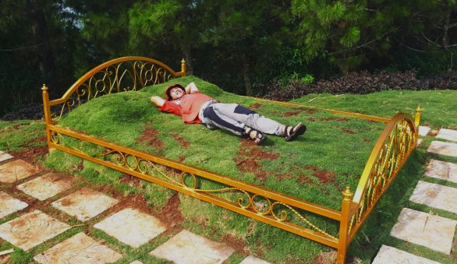
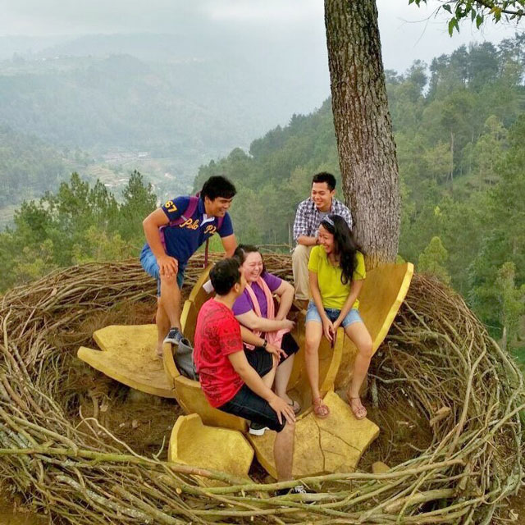
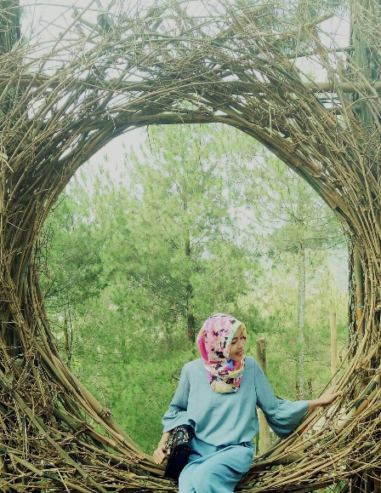
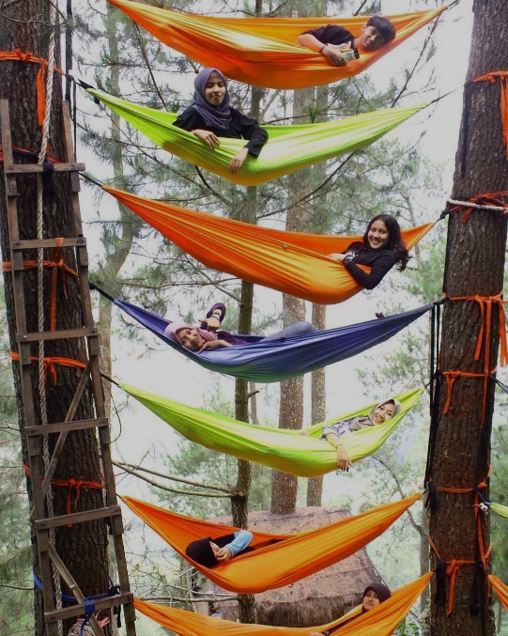
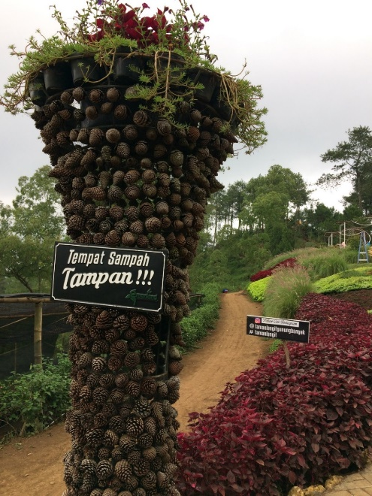
Taman Wisata / Nature Parks
Simply an Instagram opportunity?

Slide 18
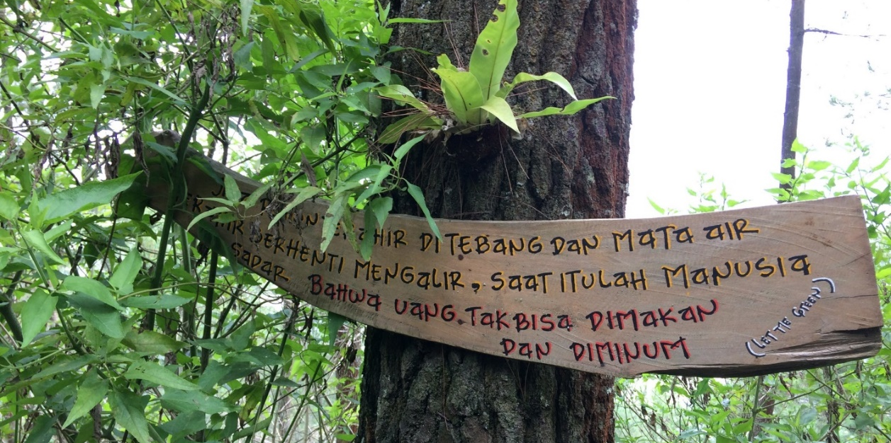
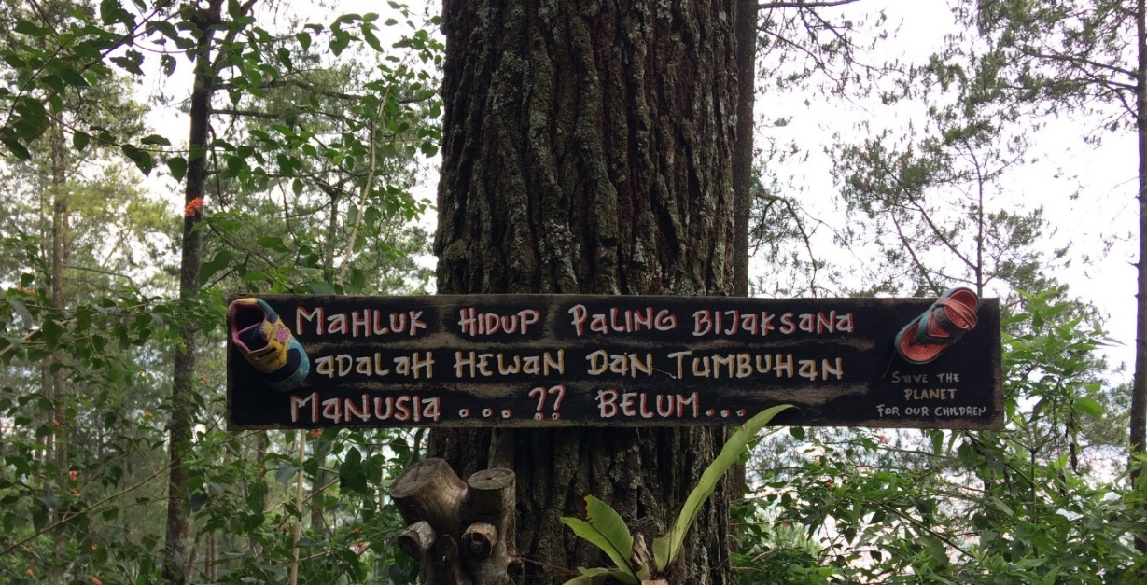
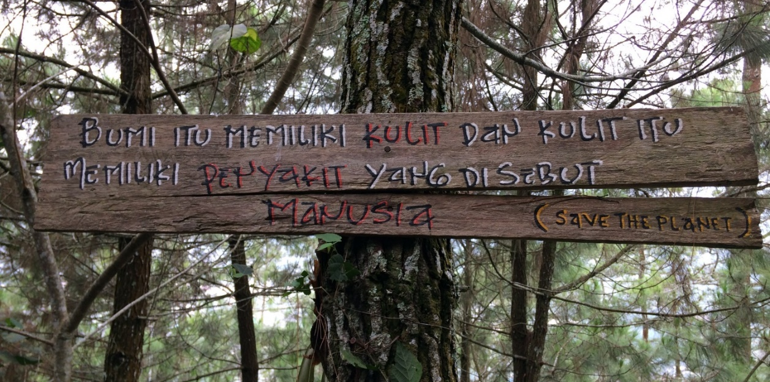
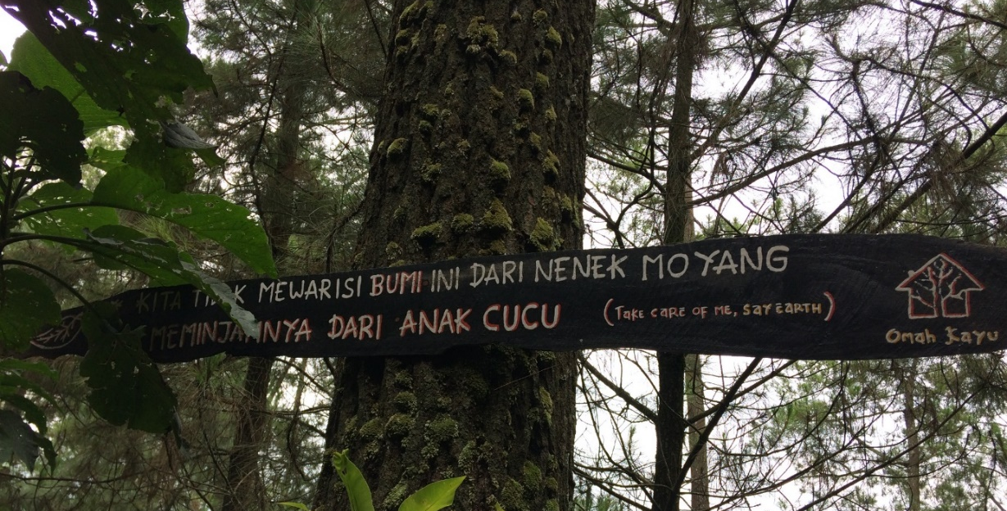

Slide 19
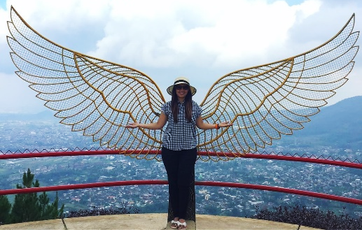
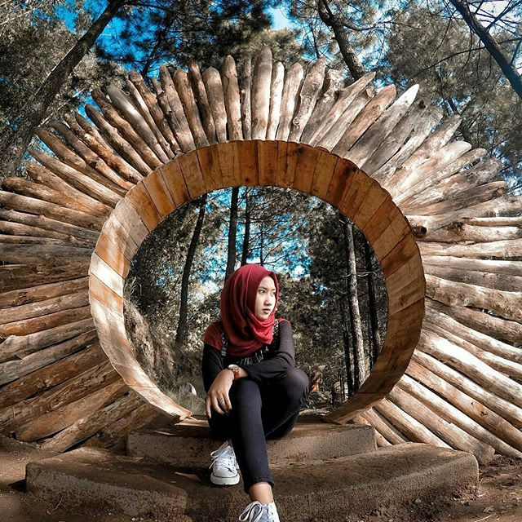
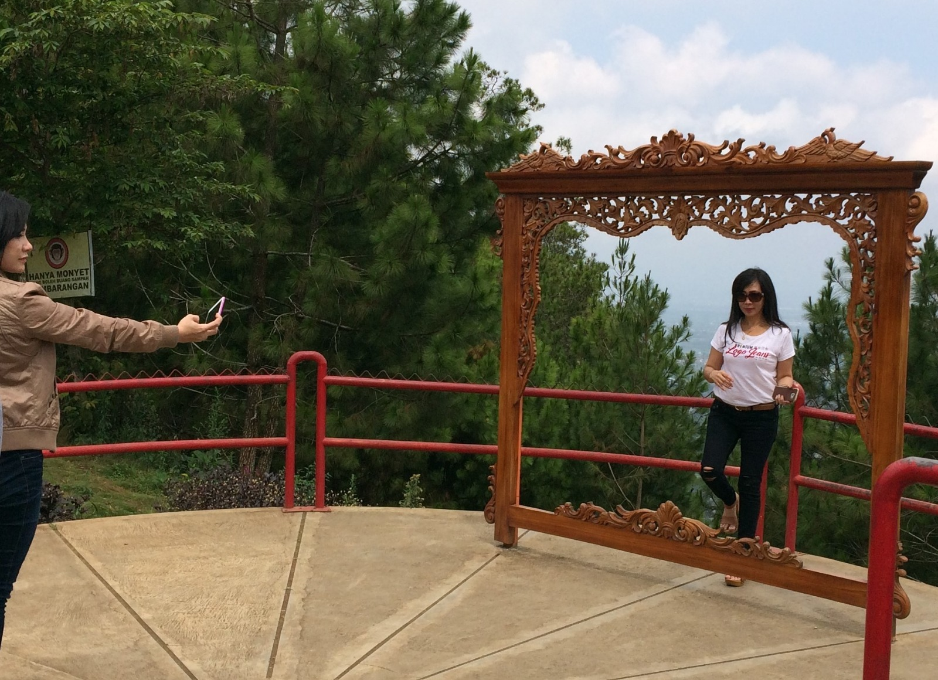
Framing Nature
Environment as an object for middle-class consumption
Gaps between conservation messages and practices
Green-washing and questionable profits from eco-branding

Slide 20
ONLY MONKEYS
ARE ALLOWED TO THROW RUBBISH
CARELESSLY

Slide 21
Framing Nature
Environment as an object for middle-class consumption
Gaps between conservation messages and practices
Green-washing and questionable profits from eco-branding

Slide 22
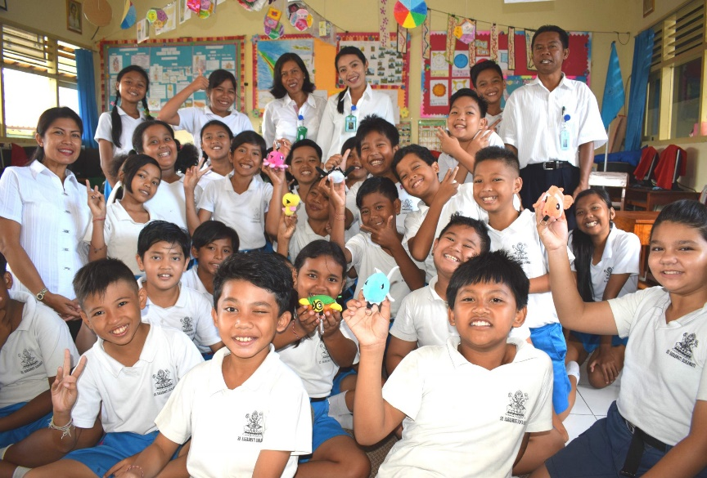
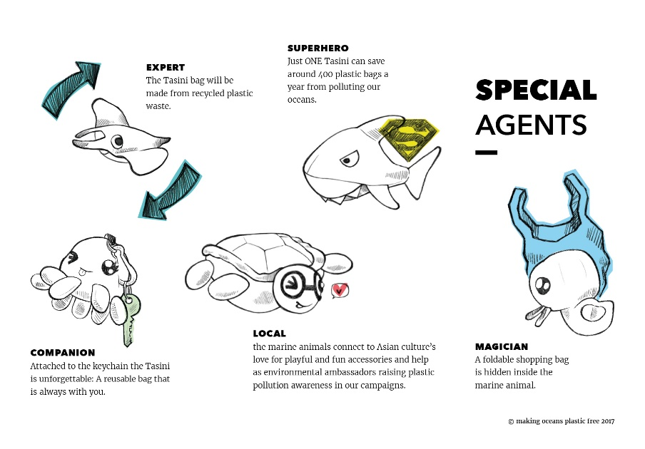
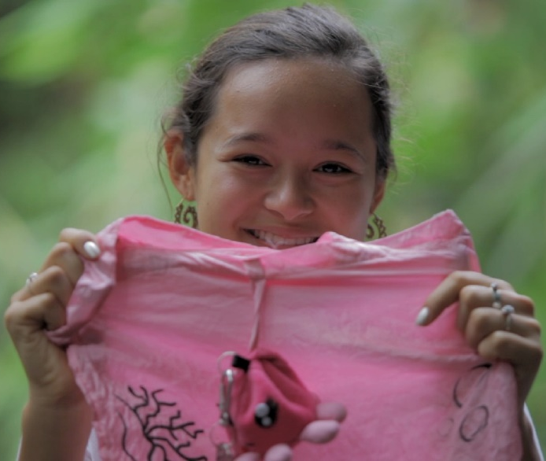
Campaigners & Influencers

Slide 24
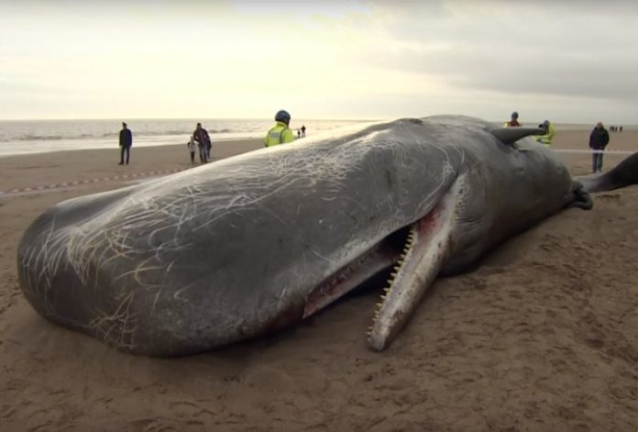

Slide 25
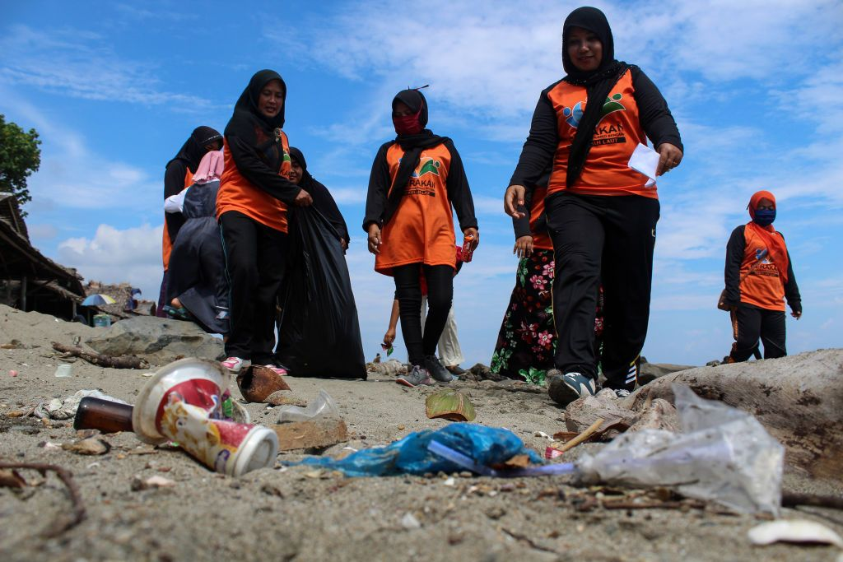
The Viral Whale
Transforming public discourse
Increased mainstream media coverage of the plastic crisis
Governments and corporations starting to take notice

Slide 26
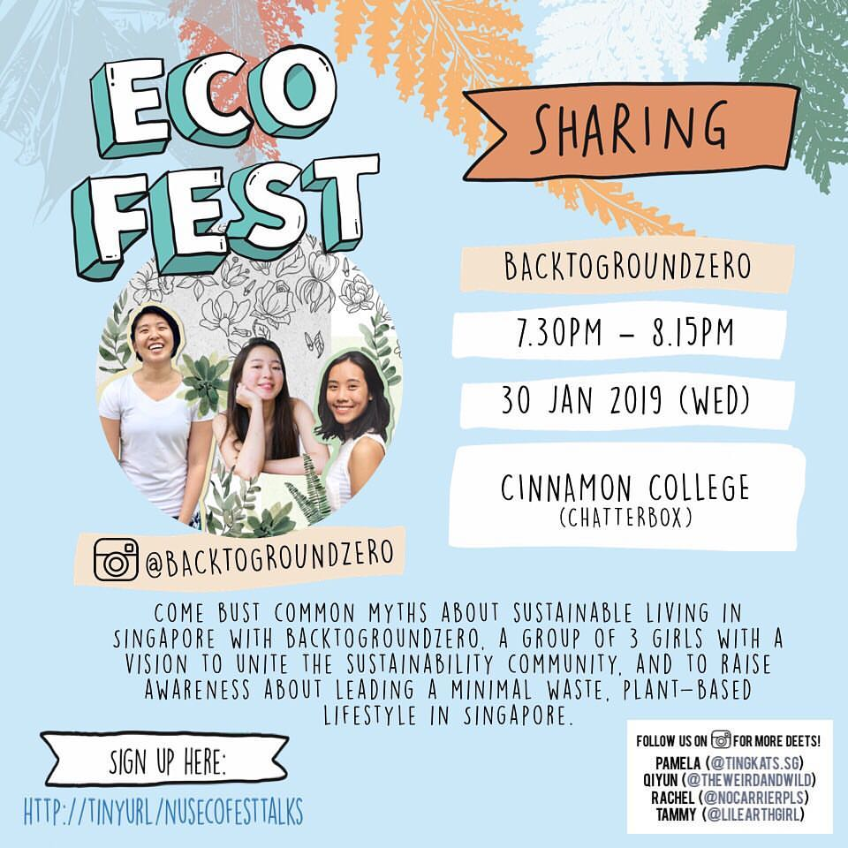
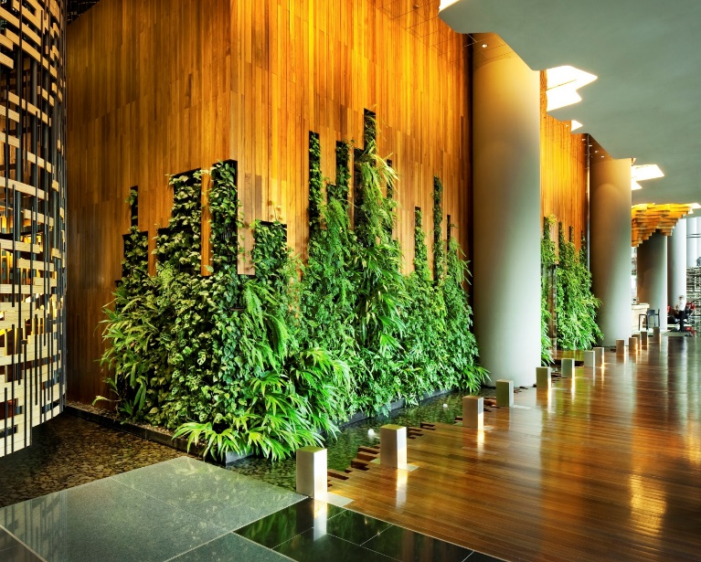
Waste-free Singapore
Online action: @lilearthgirl @byobottlesg @theweirdandthewild @nocarrierpls @ericbeajw @nor_lastrina @consciousliving.co @sunshineisgreen @tabaogirl @mariaubergine

Slide 27
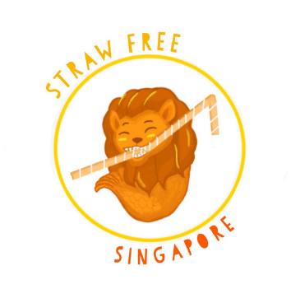
#iReject Plastic Straws
Debates over single issue focus
Rise of the #iAccept movement
Lack of consultation and participatory implementation

Slide 28
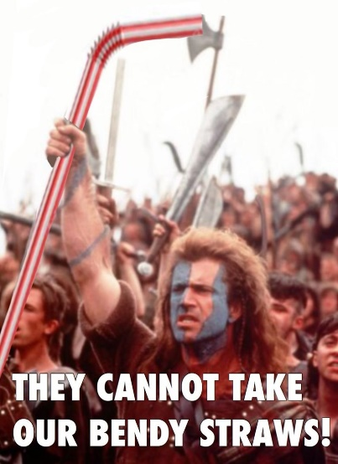

Slide 30
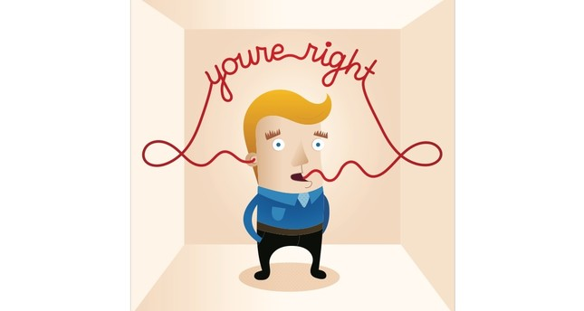
humour
Themes
emotive stories
inclusive campaigns
powerful images
Blame
Class
Scale
Virality
viral memes
BREAKING THROUGH THE ECHO CHAMBERS

Slide 31
Stories, Framing, Agenda-Setting

