Slide 1
Women at Peace Table in Asia
Evi Eliyanah
One Asia Lecture Series
09 April 2019

Slide 2
Find the pattern!
Konferensi Meja Bundar, Indonesia-Netherland, The Hague 2 Nov 1949
Syria Peace Talks, Vienna, 14 November 2015
Notes:
Women are hardly involved

Slide 3
Continue observing!
Afghanistan Peace Talks, Kabul, 18 Jan 2016
San Francisco Peace Treaty, Soviet-Japan, SF 1956
Notes:
Delegations from Afghanistan, Pakistan, The United States of America and China discuss a road map for ending the war with the Taliban at the Presidential Palace in Kabul, Afghanistan, Jan. 18, 2016

Slide 4
Structure of my lecture
Aim: to answer why women must be able to represent themselves at the peace table?
Gendering War and Peace
The involvement of women in peace talks
Conclusion
-Disclaimer : Apologies for the boring slides because I don’t have the heart to show effects of war on screen. And yes, because WAR is UGLY!

Slide 5
When I say “war” what are the first things appear in your mind?
Go to mentimeter.com and use the code 28.55.95

Slide 6
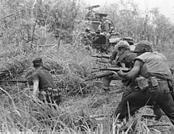
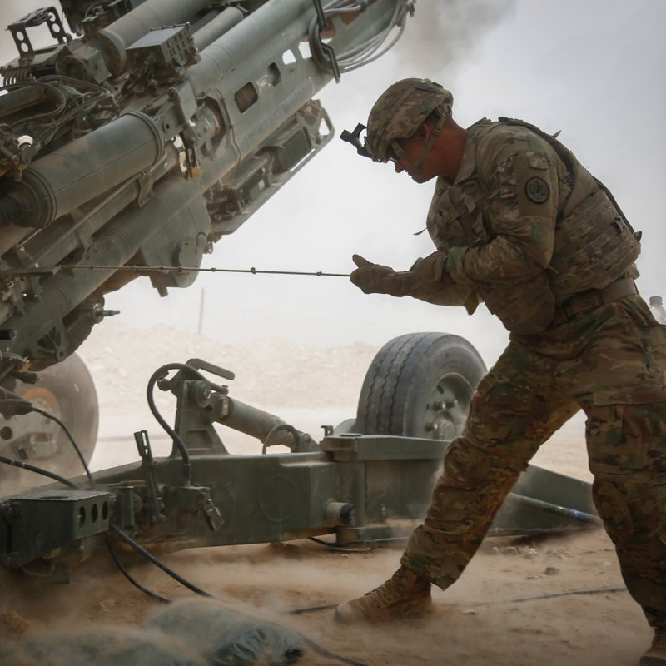
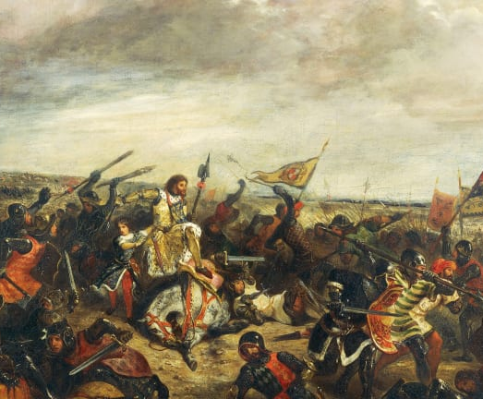
Gendering War
A simple google search. Observe the pattern.

Slide 7
When I say “women in war”, what appears in your mind?
Go to mentimeter.com and use the code 28.55.95

Slide 8
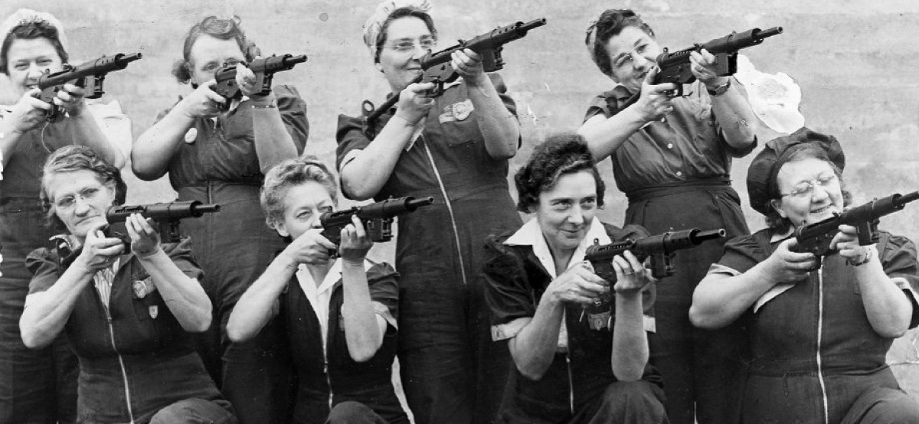
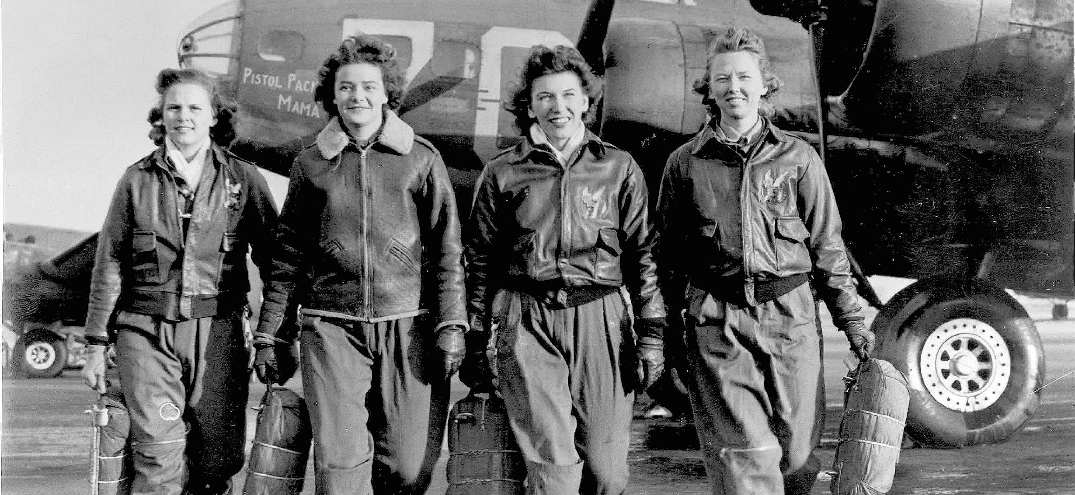
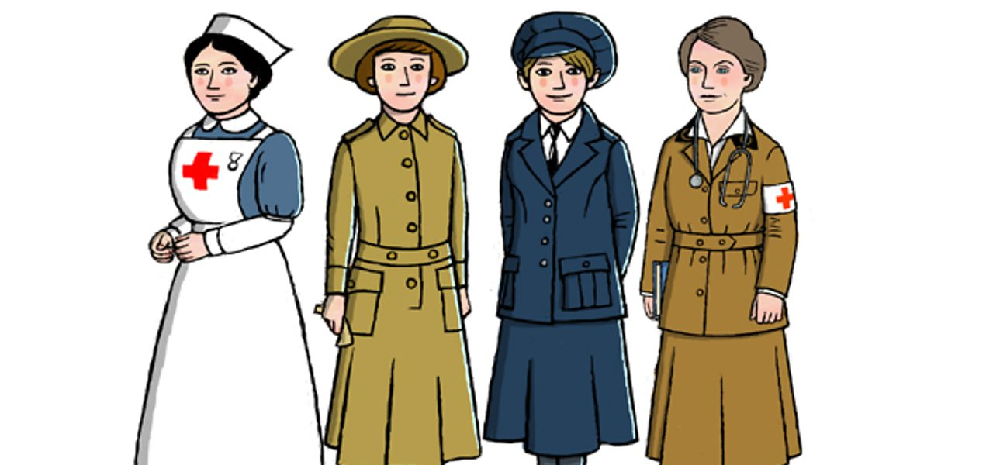
Women in war
Only when you add “women” as a keyword you will find these images.
Notes:
American Women in WW2
A BBC illustration on the stereotypical roles of women in war: nurse, doctor, ambulance driver, WAAC worker
What was the Women's Army Auxiliary Corps?
By 1917 the Army was running short of men.
The War Office realised that some front line jobs which did not involve fighting were being done by men. They decided that women could do these jobs instead.

Slide 9
Women’s roles in war
According to Françoise Thébaud (2014) on French women’s roles during World Wars
Nurse
Soldier’s “godmother” (an arrangement made in several countries, esp. in France, for women to “adopt” a soldier isolated from his family, write to him and take him when he was on leave.)
Female workers in wartime factory
Women in the countryside who took up men’s work as the latter were drafted
Women bringing up children on their own while their husbands were at the war zones

Slide 10
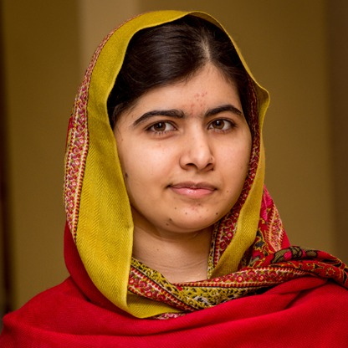
But women (and children) know (armed) conflicts like no other… (1)
More prone to becoming victims, i.e. limited mobility to escape from airstrike/gunfire – because most of them are civilians, very easy targets
Some Cases:
A Saudi-led airstrike in the residential area in Al-Makha, Yemen (24 July 2015) killed 65 (13 children and 12 women), injured 36 (14 children and 13 women)
Airstrike in Garmser district, Afghanistan, during operations conducted by pro-govt forces against Taliban killed 23 civilians, among them were 10 children and 8 women. (2018)
US Airstrike in Afghanistan in Feb 2019 reportedly killed 10 civilians, most of whom were women and children.
Malala Yousafzai, then a young woman activist, was shot in her head by a Taliban soldier in retaliation of her activism in 2012. At that time, she, only 15 years old, was on her way home from attending school exam.
Notes:
Preliminary findings from the UN Assistance Mission in Afghanistan (UNAMA) indicate that as many as 23 civilians were killed and three injured Tuesday in an airstrike in Garmser district of Helmand province during operations conducted by pro-government forces against Taliban in the area.
Initial findings indicate that the vast majority of the victims were women and children. The Mission is actively working to verify information indicating up to 10 children were killed along with eight women, and three children were injured, including an eight-year-old boy.

Slide 11
But women (and children) know (armed) conflicts like no other… (2)
Harmed by breakdown of law → no protection from any kinds of violence:
domestic violence (87% of women experienced domestic violence in Afghanistan
many girls are pushed into transactional sex in Liberia;
we also know well enough in the history of Indonesia, Korea and Japan of the countless women being pushed into becoming comfort women and experiencing sexual violence perpetrated by combatants

Slide 12
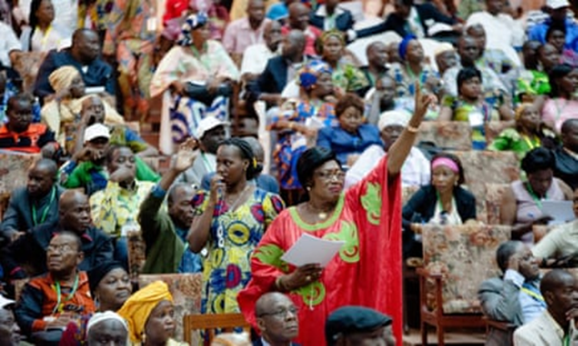
A Story from DRC, a reality in any armed conflict
Notes:
On Tuesday, 13 October 2015, Julienne Lusenge, a veteran campaigner for women’s rights in the Democratic Republic of the Congo (DRC), addressed the security council. She began by saying she had spoken to the body before and had thought long and hard about whether to do so again.
Seven years earlier in 2008, Lusenge had described to the council the rapes, murders and massacres ravaging her country. She had asked for action to enable peacekeeping operations in the DRC to better protect women from sexual violence. Lusenge told them bluntly: for women caught up in conflict in the DRC, almost nothing had changed. The trafficking, rapes and murders continued. Local organisations trying to support survivors of sexual violence struggled to find the necessary resources. And attempts to achieve peace and stability were largely ineffective and unsustainable.

Slide 13
Gendering Peace Talks
Syria
In earlier talks on Syria, Syrian women were ignored. From the picture of the Vienna peace process on Syria in October – where 18 men and one woman sat round the table – nothing seems to have changed.
Afghanistan Afghan women’s rights activists over being excluded from the session on Afghanistan at the NATO conference at Newport in 2014 that one prominent activist staged a protest in the car park outside.
Indonesia
Aceh, not a single article in the Helsinki agreement that concluded hostilities in Aceh (2005) touches on gender issues. → Shadia Marhaban, the only woman involved in the talks, Martti Ahtisaari’s strategy was to spend five months on core issues such as security, politics

Slide 14
In short …
The fact remains that women and girls are far too often targeted for violence in armed conflict, and are simultaneously excluded from efforts to prevent, resolve, and rebuild from these complex crises.
From 1992 to 2011, less than 4%of participants in peace agreements and less than 10% of negotiators at peace talks were women, according to UN data
SO WHAT?

Slide 15
Every time women are left out of the peace table, a lot opportunities of peace are lost…
Statistical reports have found that when women are included in peace processes as witnesses, signatories, mediators, or negotiators there is a 20 percent increase in the probability that any agreement will last at least two years, and a 35 percent increase that it will last at least 15 years.

Slide 16
When women are involved in peace talks
Peace processes are less likely to be simply a negotiation about power among men with guns, but rather to include broader issues about how to build a sustainable peaceful society.
i.e. important recognition of gender-based violence as effects of war, access of basic needs (food, water, safe shelter, education, health) are discussed as primary

Slide 17
However, NOT TOKEN WOMEN!!!
Inclusivity is the key for creative, long-term solutions. Work with women leaders at any levels.
Notes:
The participation of women in this way does not mean trying to squeeze them into processes that are in and of themselves broken. Rather, it entails working with women leaders—from the local to national to regional to international levels—to seek creative, long-term solutions to seemingly intractable problems. Inclusivity is the key.

Slide 18
Conclusion
Experience of war is gendered.
In order to achieve comprehensive, long-term and intractable solutions to armed conflicts, the involvement of (NOT TOKEN) women are imperative.
https://www.youtube.com/watch?v=GayuKnUWwXQ&feature=youtu.be

