Slide 1
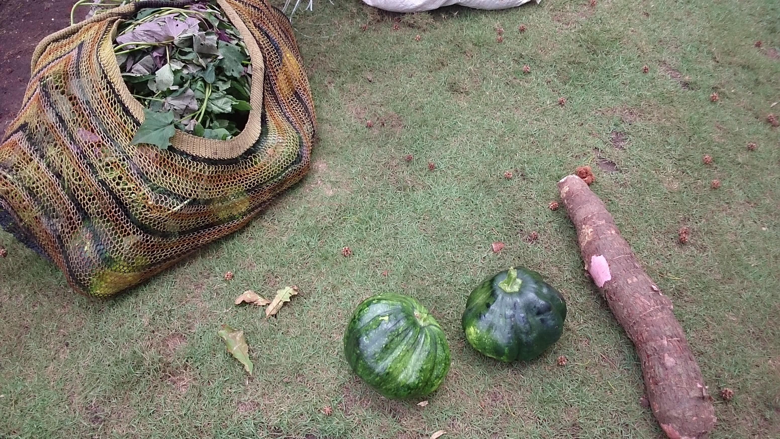
Local leadership and peace in Papua
Yulia Indri Sari

Slide 2
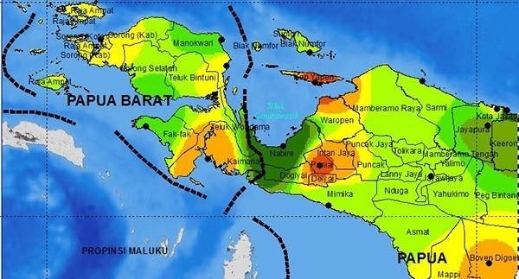

Slide 3
If you heard Orang Papua, what would be the first thing on your mind?

Slide 4
STREOTYPE – LABEL
Dangerous
Smelly
War
Drunk
Primitive
Exotic
Adventure
Rajaampat
Koteka

Slide 5
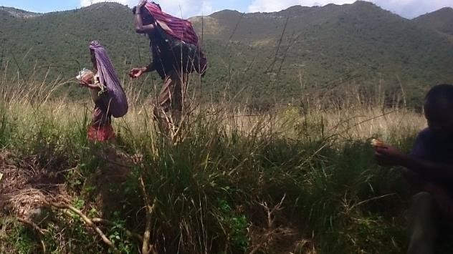
Orang asli Papua (indigenous/native Papuans) Melanesians

Slide 6
Various types of hierarchical clans
The traditional social structure revolves around kinship relations (communal hierarchy, access to land and resources, paternal heredity line)
“Wantok” “one talk”, suku, fam, klan
Exclusive ties can occur in one clan where access to particular resources is restricted to clan members or to wantok only

Slide 7
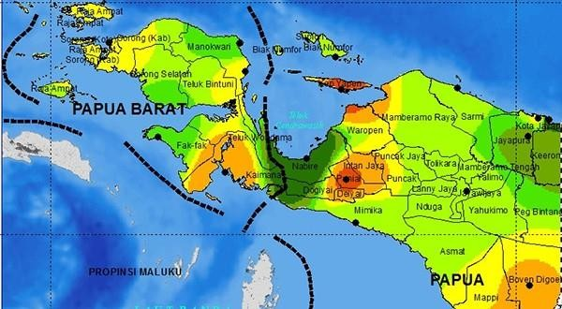
ORANG GUNUNG (HIGHLANDERS)
ORANG PANTAI (COASTAL PEOPLE/SOCIETIES)

Slide 8

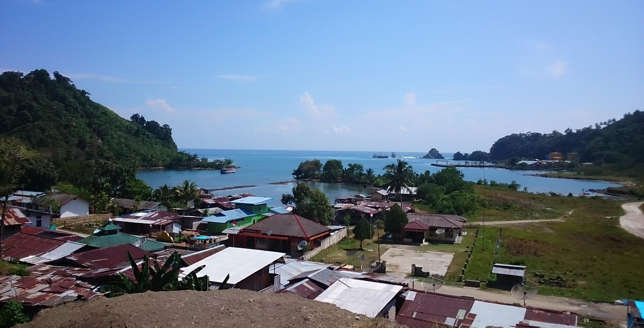

Slide 9
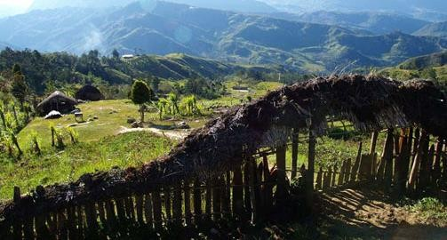

Slide 10
BIG MAN LEADERSHIP
through competition (achieved status)
Broad range of resources in the
‘Big Man’ system → own pigs, skills in fighting, hunting, sorcery, oratory, money/program, skills/knowledge
Ref: Standish 2007; Alua 2006; Mansoben 1995;
Sahlins 1963

Slide 11
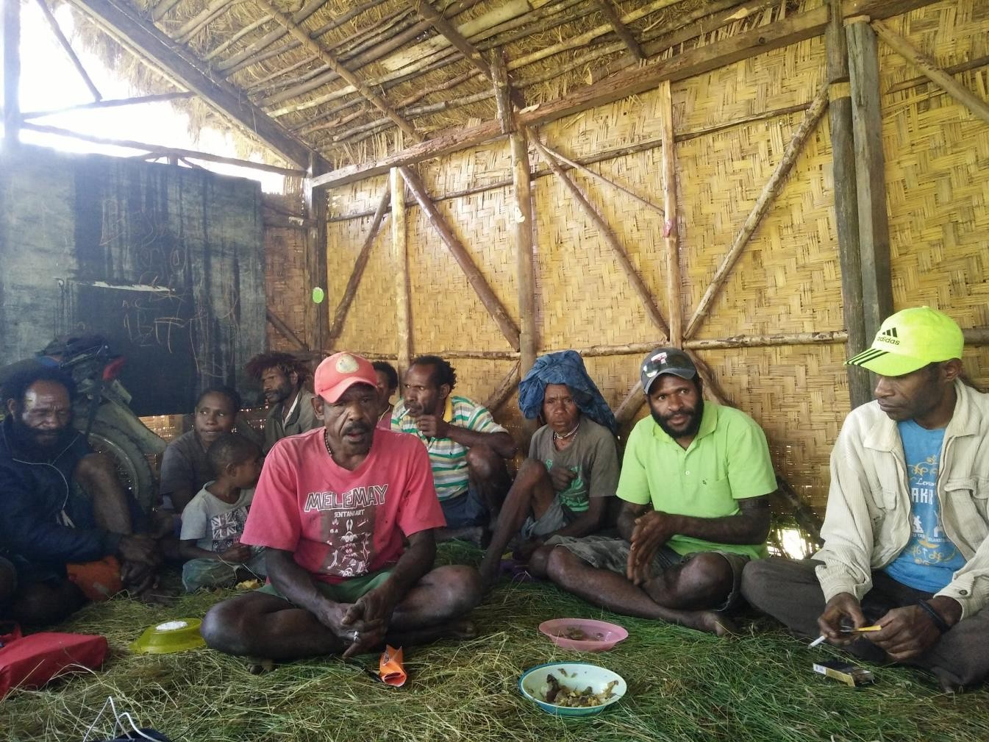
“Generous” Big Man leadership:
Ability to accumulate resources and distribute these equally to members
Community decision making was predominantly consensual
Community-oriented type of leadership
Relatively equal distribution of resources

Slide 12
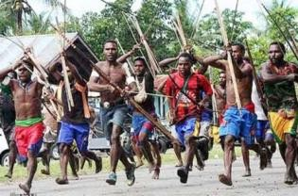
“Coercive” Big Man Leadership:
Warfare skills: aggressive and strong Big Man
Failure to equally distribute resources to all clan members
Opposition, conflict, warfare →
“Baku mulut”, “Baku hantam”

Slide 13
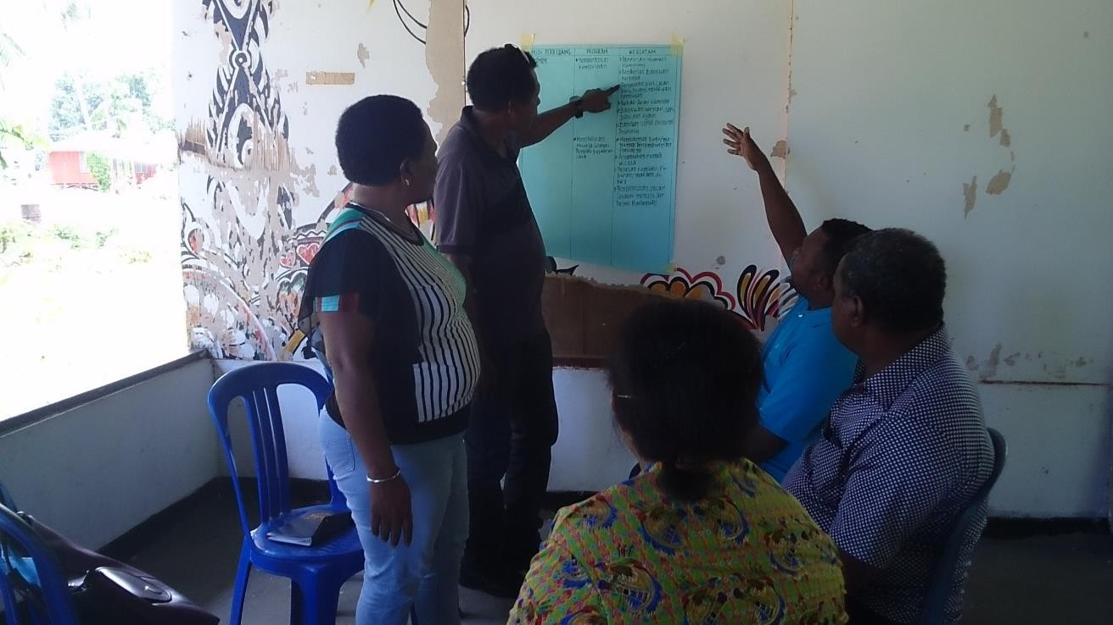
Chieftaincy leadership
Chief comes to a position of power by inheritance or ascribed status
Ondoafi/ondofolo
Centralised, hierarchical, and less competitive
“Elite meetings”
Gossips, rumours

Slide 14
ARE WE SO MUCH DIFFERENT FROM THEM?

