Slide 1
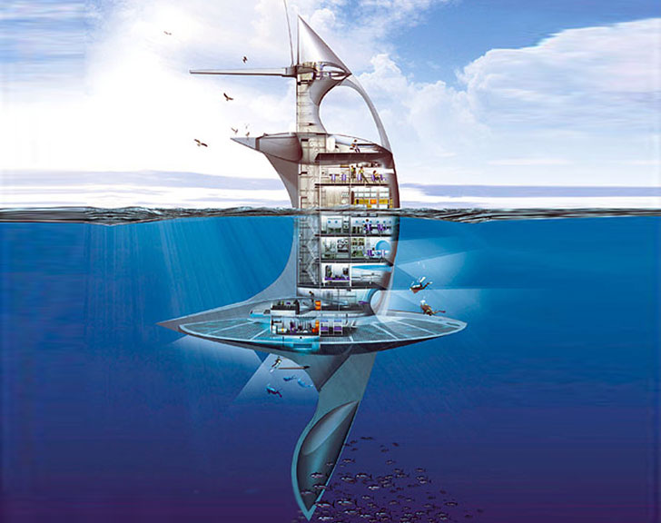
The potential of Indonesian marine exploration for creating new sensation food and health culinary based on the marine
environmental chemistry analysis
By: Anugrah Ricky Wijaya

Slide 2

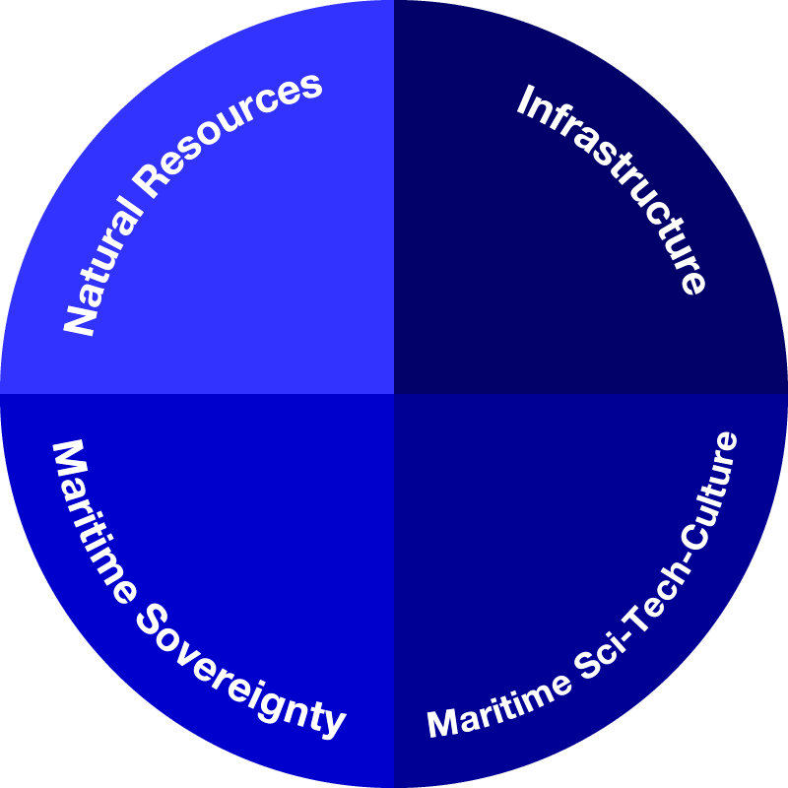









Coordinating Ministry for Marine Exploration
Scope of Coordination
Ministry of Marine Affairs and Fisheries
Ministry of Transportation
Ministry of Energy and Mineral Resources
Ministry of Tourism
+
Line ministries and agencies

Slide 3
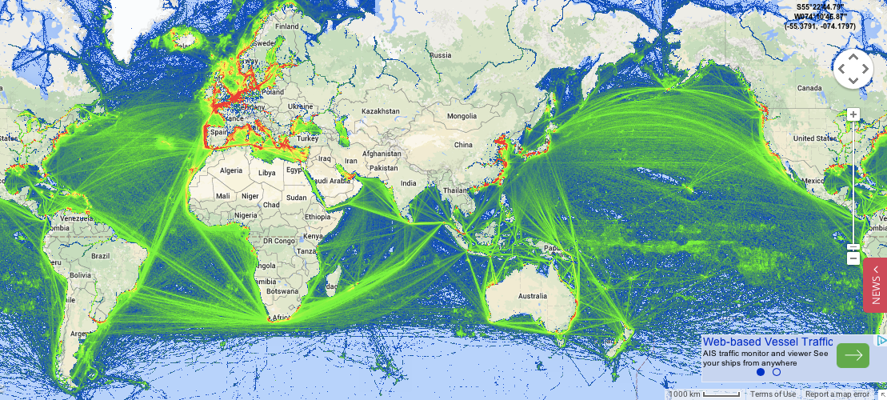
Global Maritime Axis
https://www.marinetraffic.com
Notes:
Singapura merupakan pelabuhan nomor dua setelah Shanghai. lalu lintas peti kemas [2013] 32.6 juta TEUS (Twenty Foot Equivalent Unit) (ukuran 20 feet) dan 139 ribu kedatangan kapal. Rotterdam urutan ke-11, Hamburg urutan ke-14. Lalulintas peti kemas Tanjung Priok dan Tanjung Perak, masing-masing 6 juta TEUS dan 3 juta TEUS. pendapatan dari Pelabuhan Singapura mampu menyumbangkan sekitar 7 persen dari Gross Domestic Product (GDP).

Slide 4
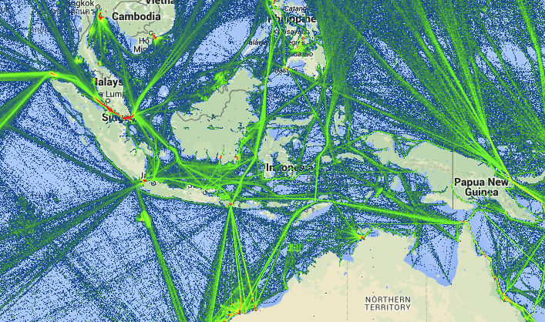
Indonesia Maritime Traffic
https://www.marinetraffic.com

Slide 5
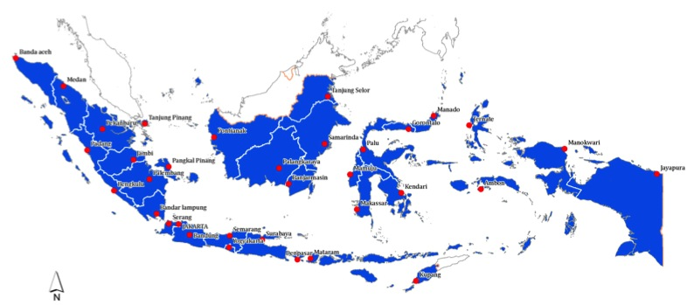
Connectivity and Logistic System
Centers and corridors of economic growth
Intermodal Connectivity
Integrated maritime logistics management
  Short sea shipping, “3 in 1” fleet
Mining & Energy
Agriculture & Fishery
Natural Resources
Agriculture & Energy
Services
Tourism
Notes:
24 new sea ports, 15 new air ports
Short sea shipping

Slide 6
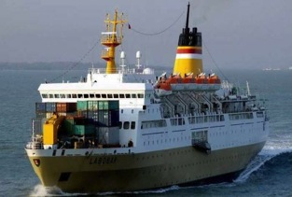
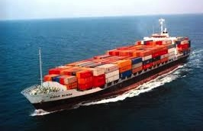
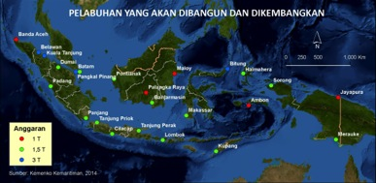
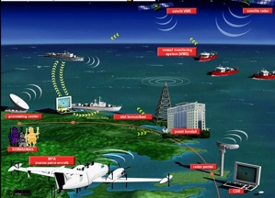
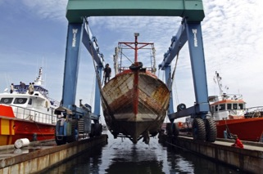
Sea Transportation
Ports: 24 new ports
Ships
  increase national fleet
Shipyards
  improve ship building capacity
  Provide incentives
Infrastructure industries
Observation systems

Slide 7
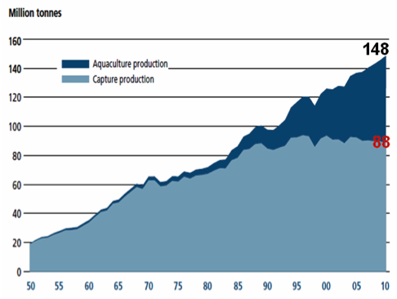
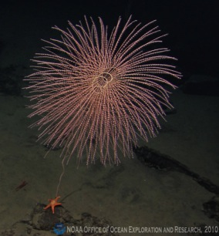
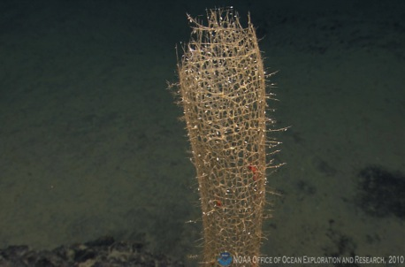
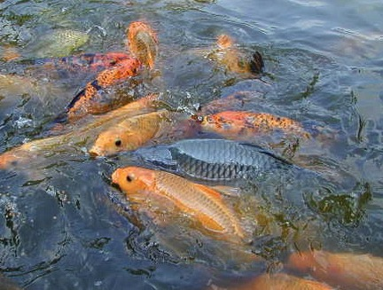
Fishery
Sustainable fishery [vs. IUU Fishing]
Aquaculture
Fish processing facilities
Protect marine biodiversity
Aquaculture
Capture Fishery

Slide 8
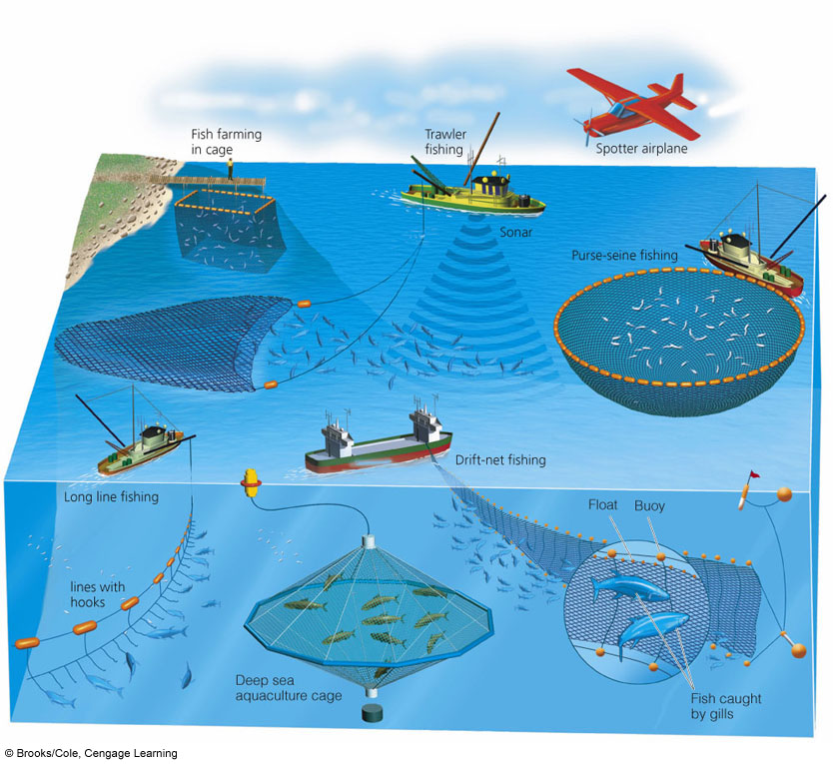
Fish Exploration

Slide 9
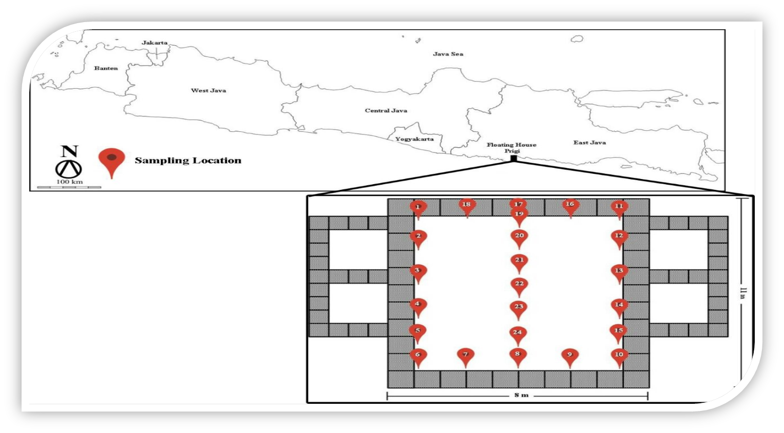
The potential of marine natural product: The Gulf of Prigi

Slide 10
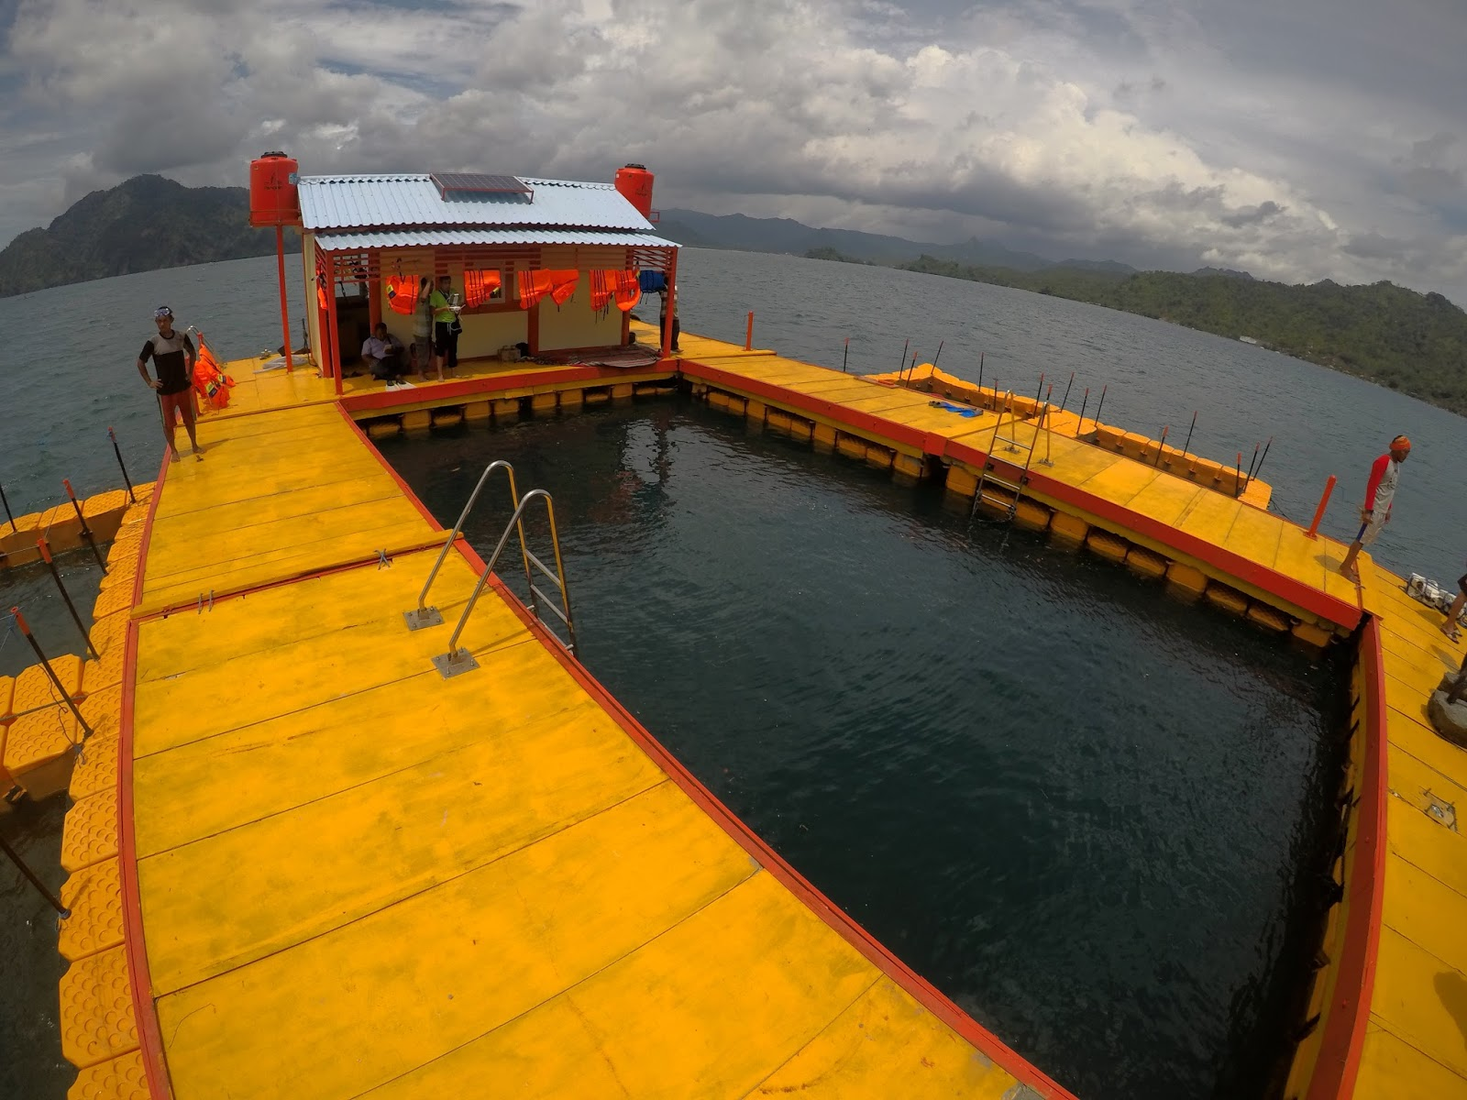
The Floating House

Slide 11
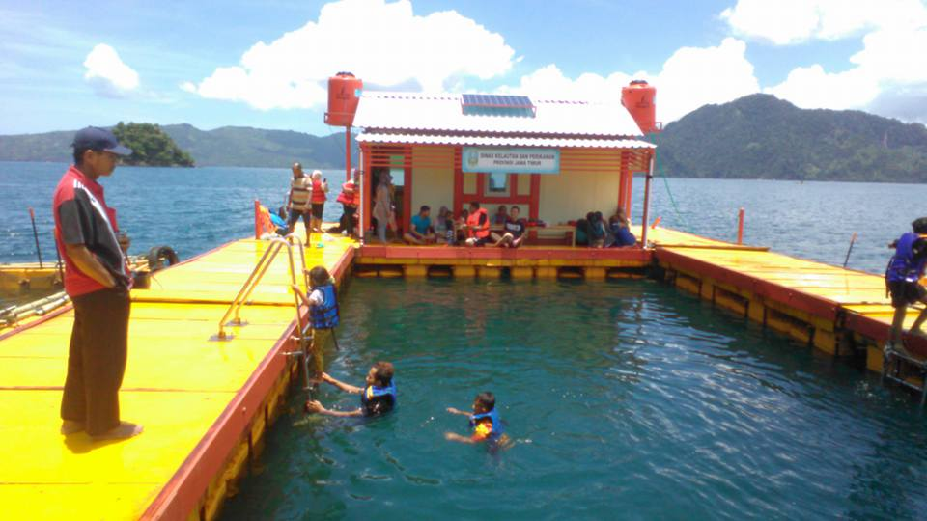

Slide 12
Wijaya et al. 2017; (Submitted to Chemosphere Journal)

Slide 13
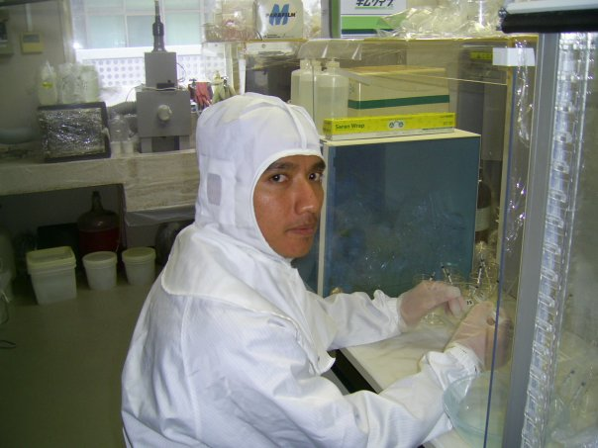


Analytical Methods
Sample
  Drying process
Dried sample
  Filtering and weighing processes
~15.0 mg
of sample
  Separating and dissolving processes
(1% HNO₃)
Soluble fraction
Solid sample
ICP-MS-Elemental analysis
ICP-MS isotope measurements
NIST-981 standards
(1ppb, 10ppb and 100ppb)
  MIST-981 (from 50ppb to 100ppb)

Slide 14
Calculation of enrichment factor and pollution index
1. Enrichment Factor
EF_{sediment} = (C_{m}/Al)_{sediment}/(C_{m}/Al)_{background.}
2. Rank or Priority index
2.1 Pollution Load Index
PLI = ………………..PLI^{N} (1)
2.2 Risk Index
RI = …………………………………..RI^{N}(2)

Slide 15
2.3 Geoaccumulation index
I_{geo} = …………………
......................
sI_{geo}^{N} (3)
Rank or Priority index

Slide 16
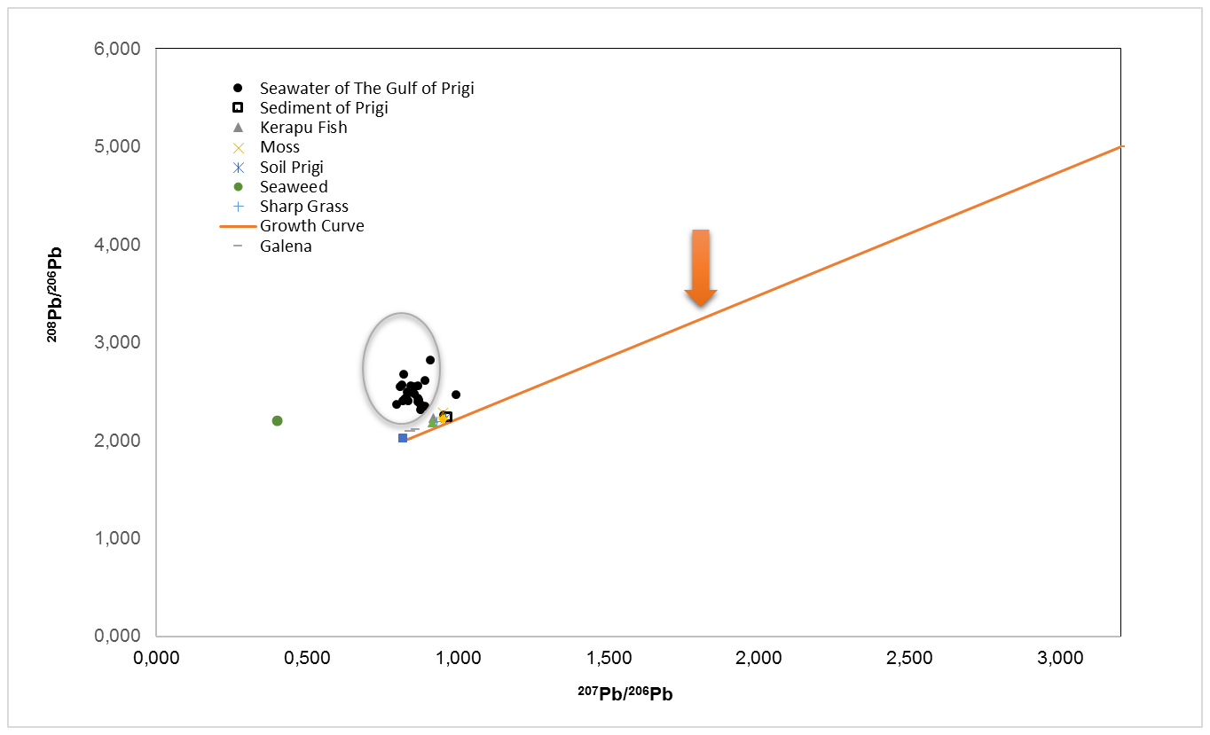
Pb isotopes as the finger print
Line of Pollution Pb
Natural Source
Wijaya et al. 2017; (Submitted to Chemosphere Journal)

Slide 17
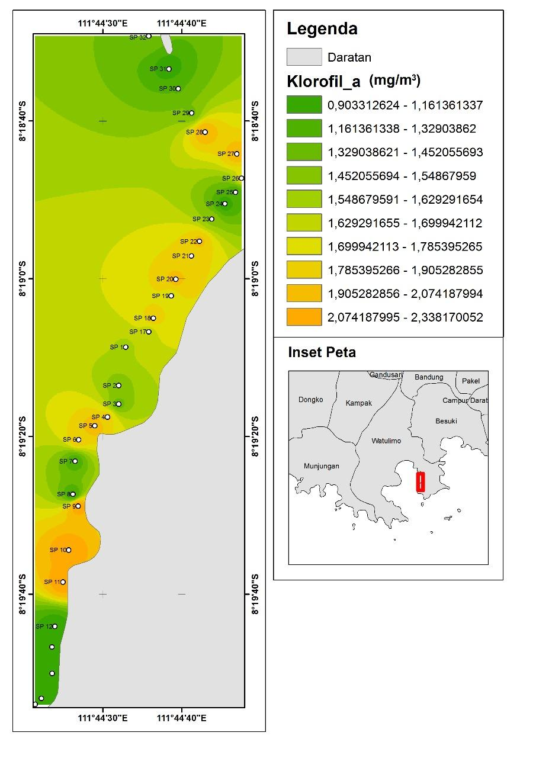
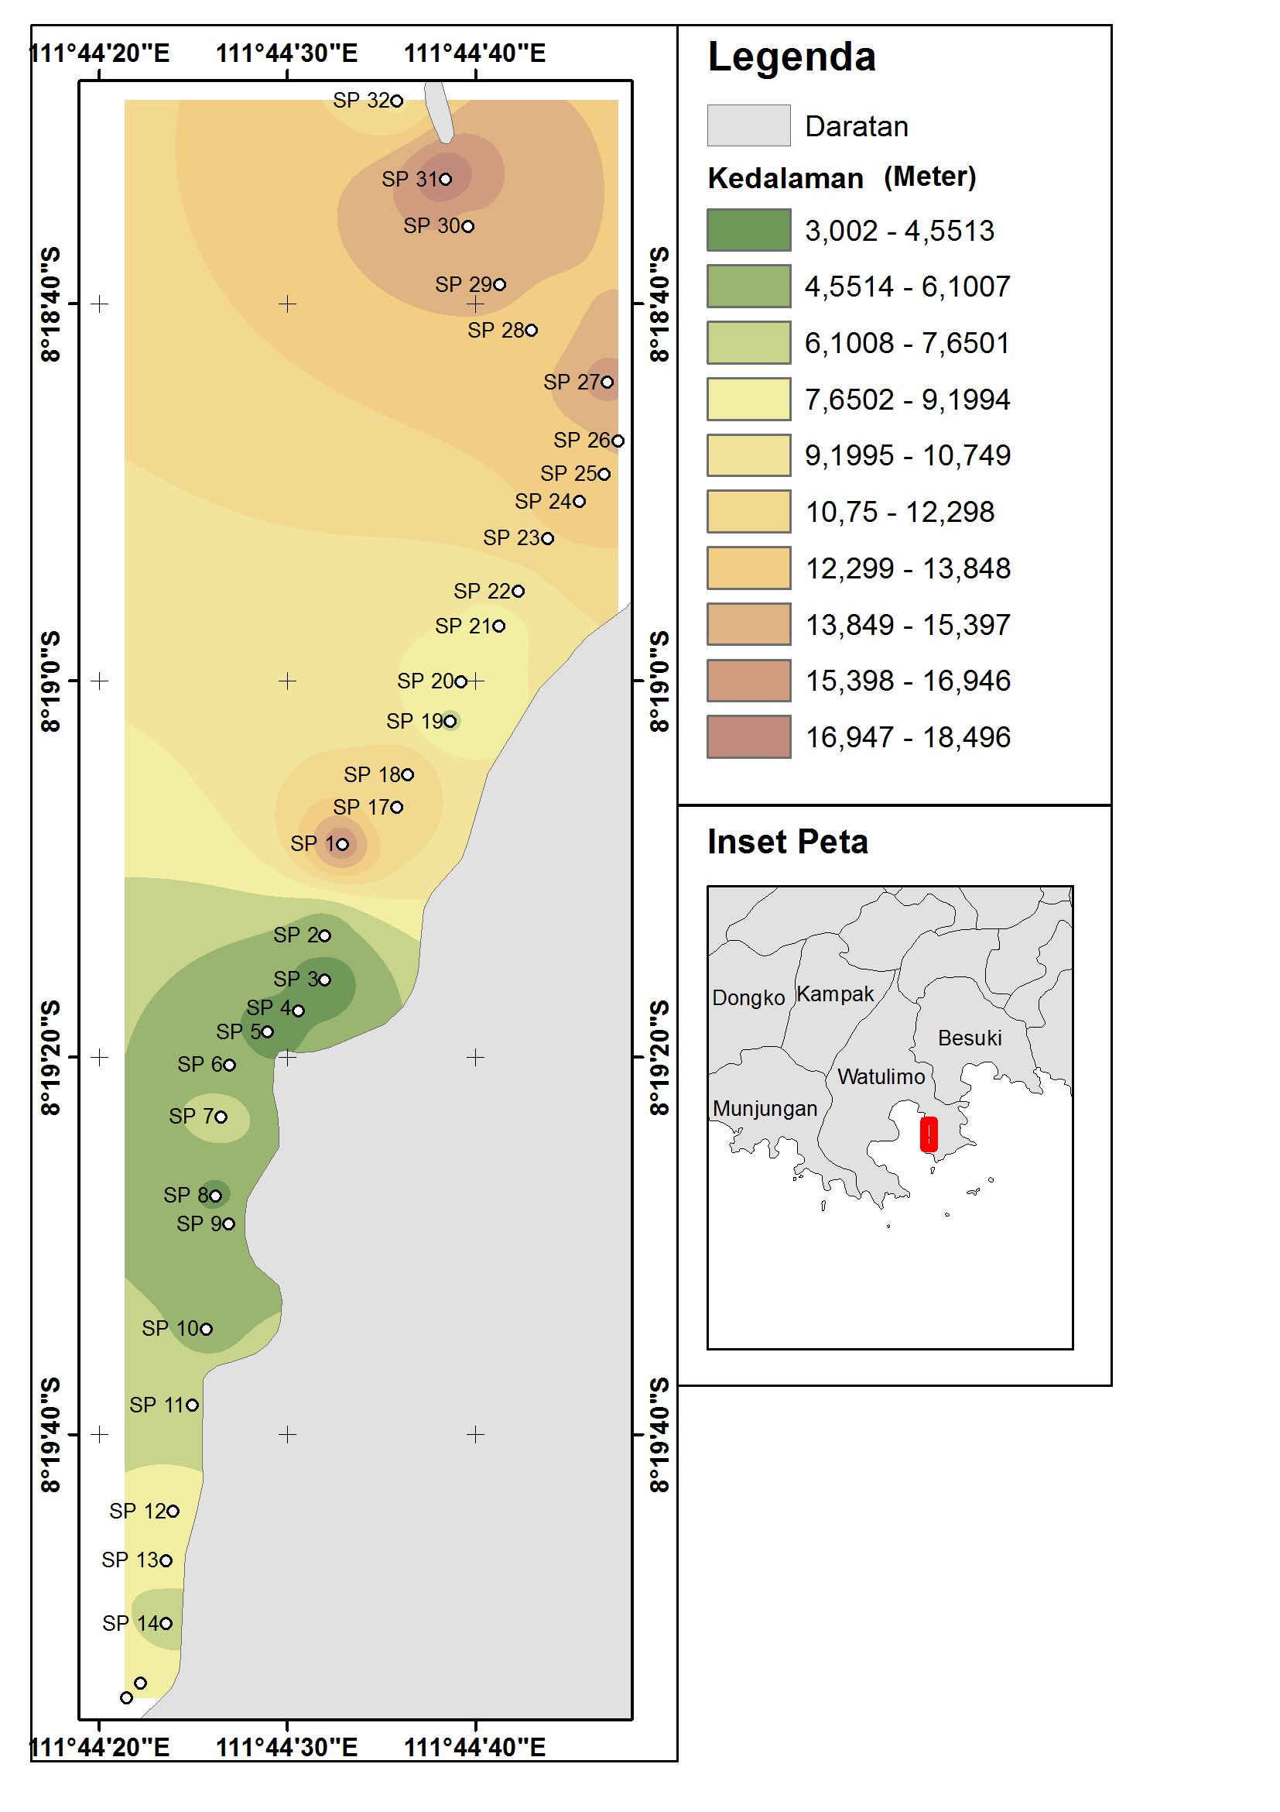
Mapping of chlorophyll contents usingaqua MODIS (Moderate Resolution Imaging Spectroradiometer)

Slide 18
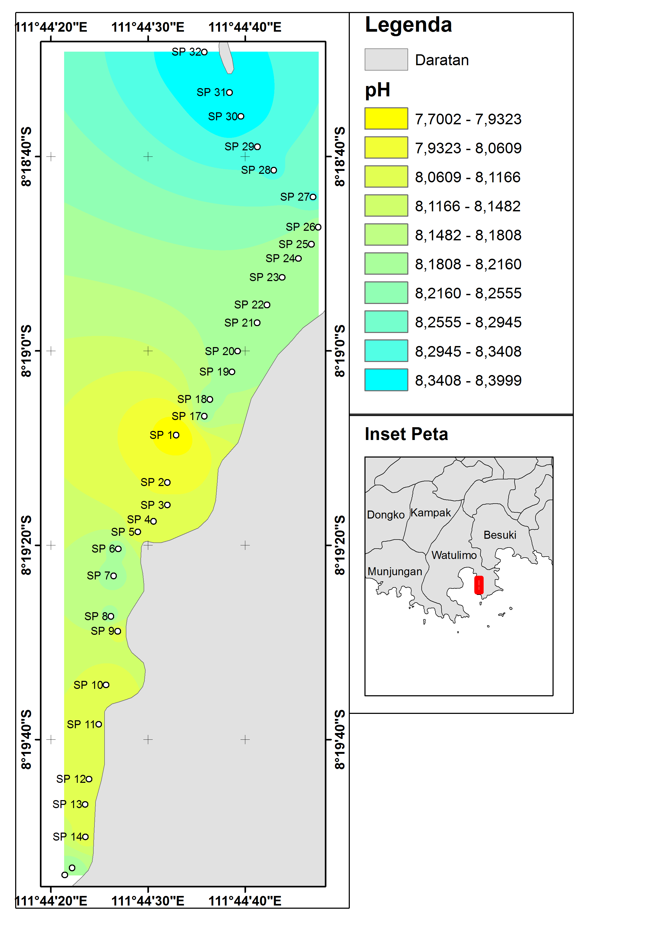
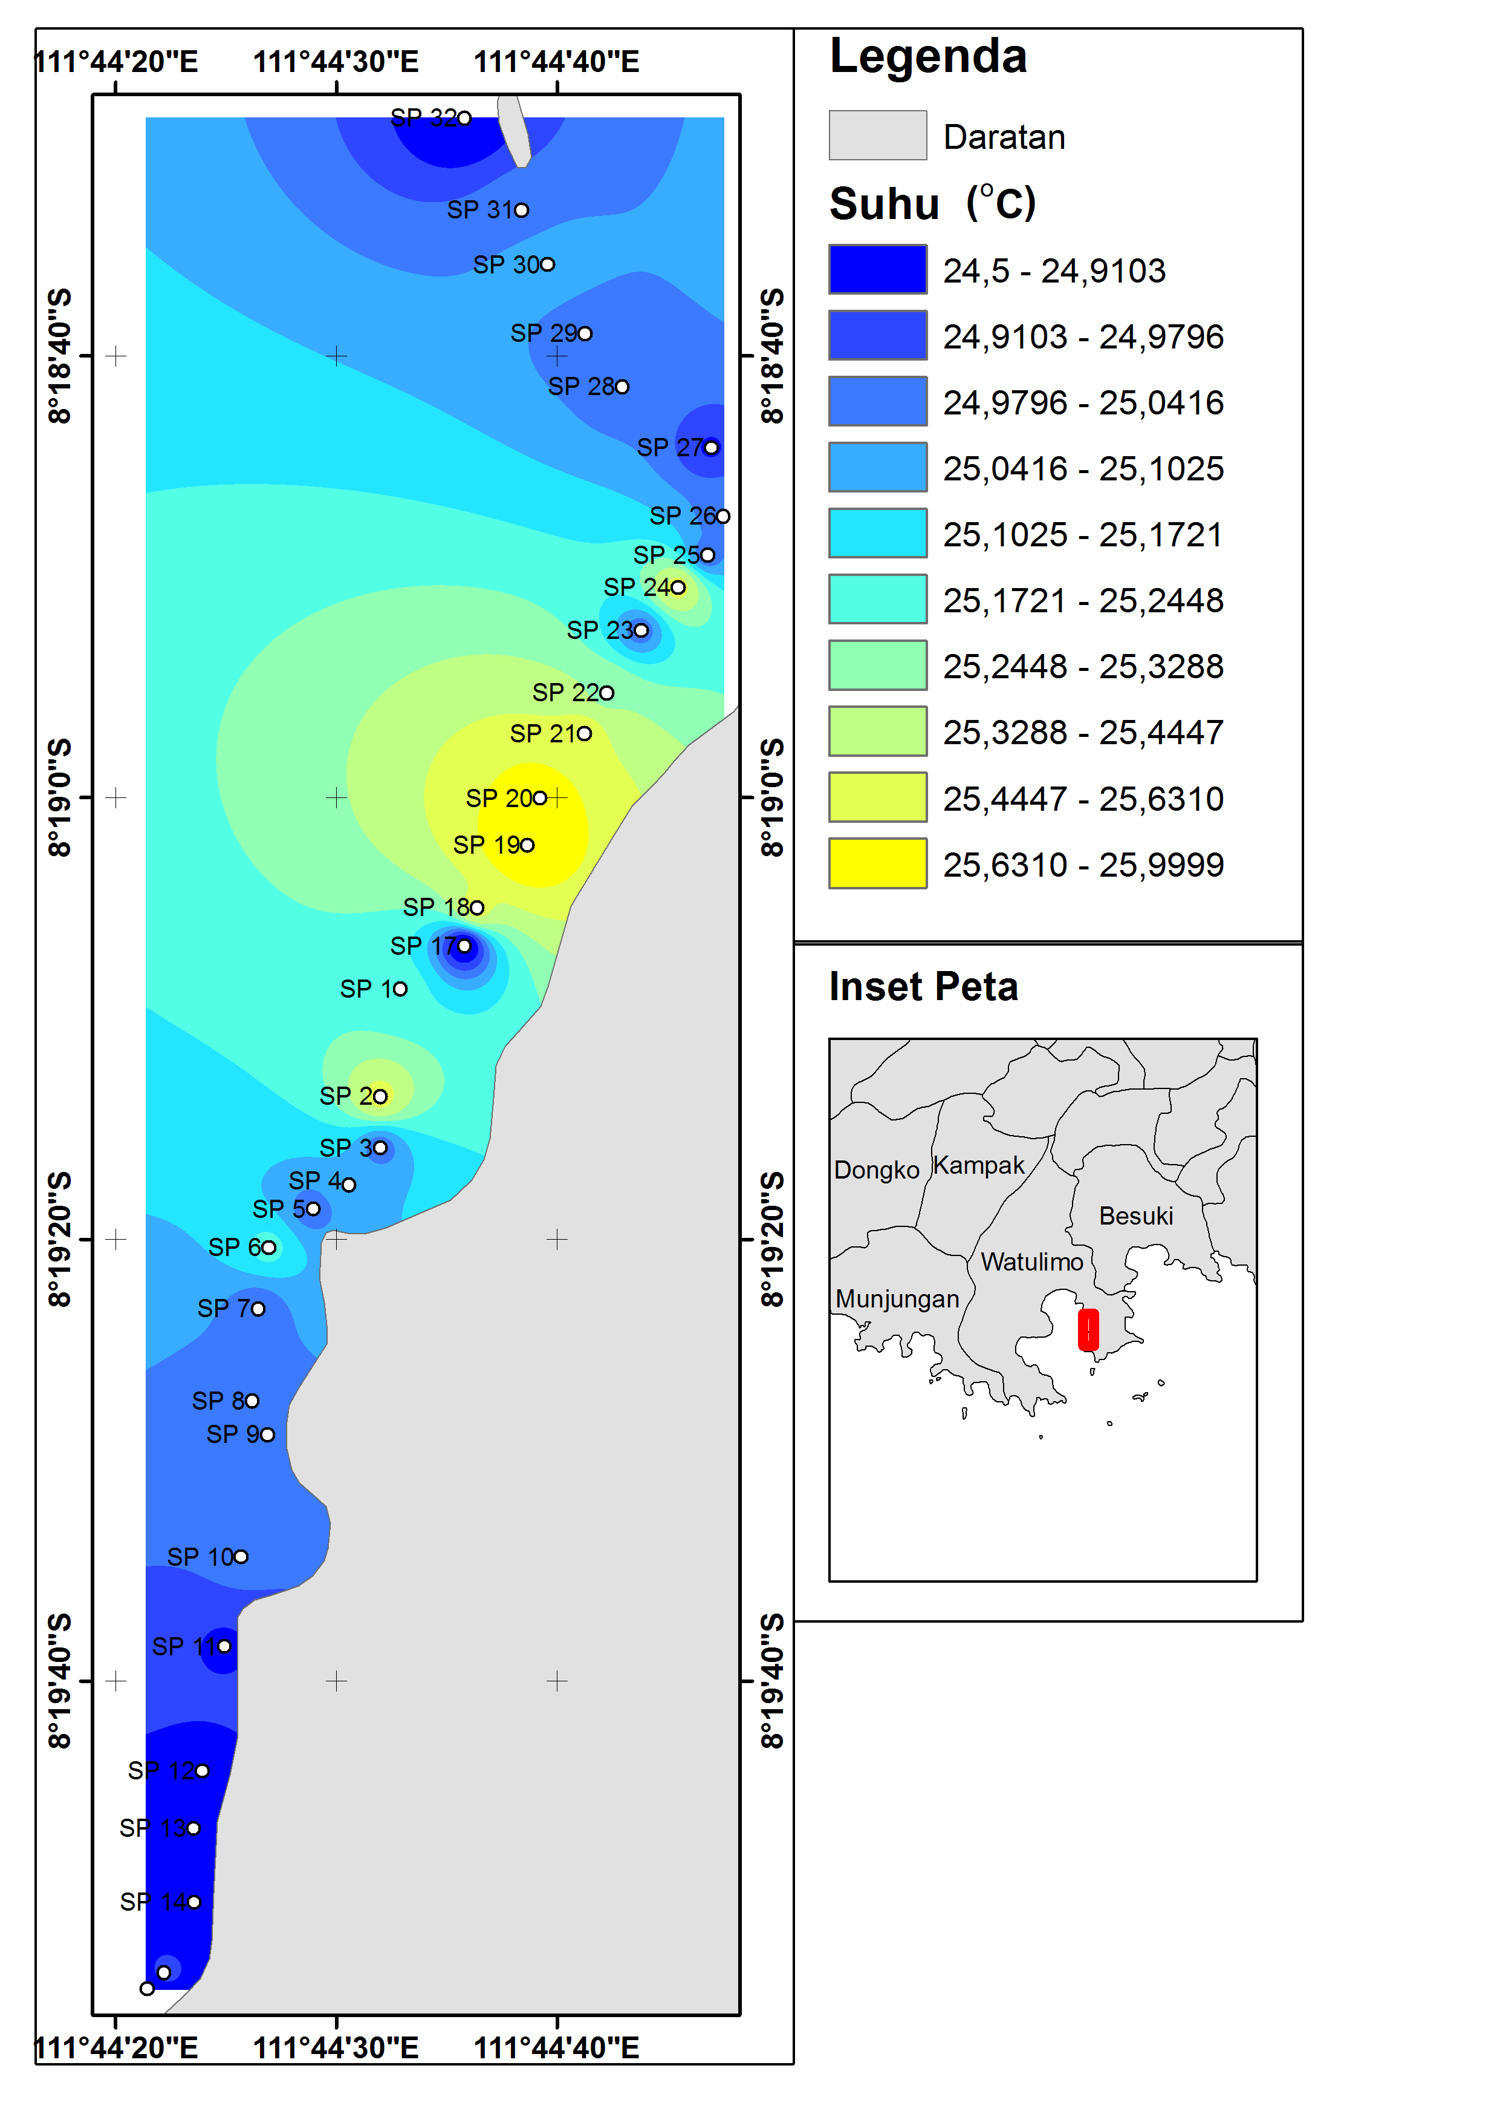

Slide 19
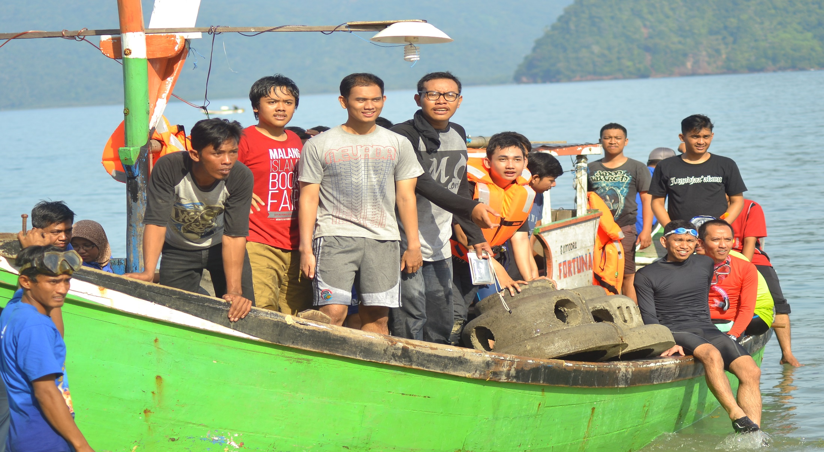
Environmental Protection by Transplanting Coral Fragments to Damaged Coral Reefs

Slide 20
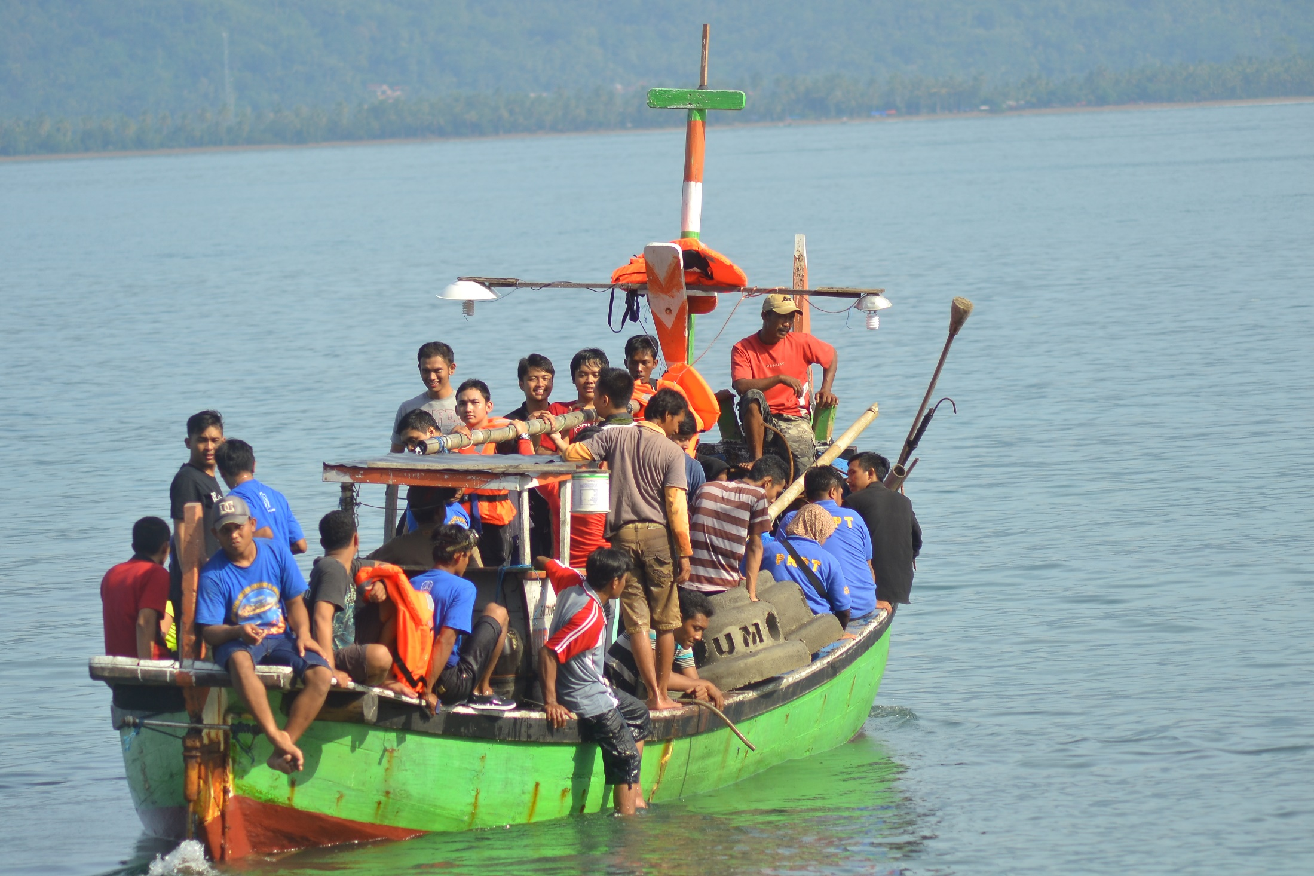

Slide 21
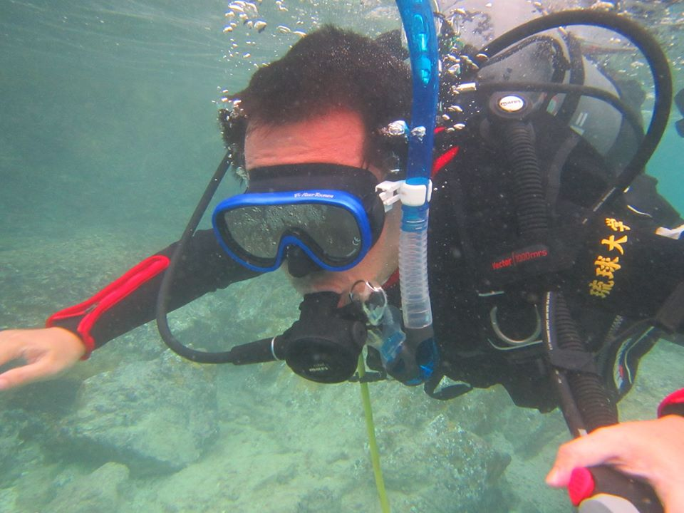
Environmental Protection by Transplanting Coral Fragments to Damaged Coral Reefs

Slide 22
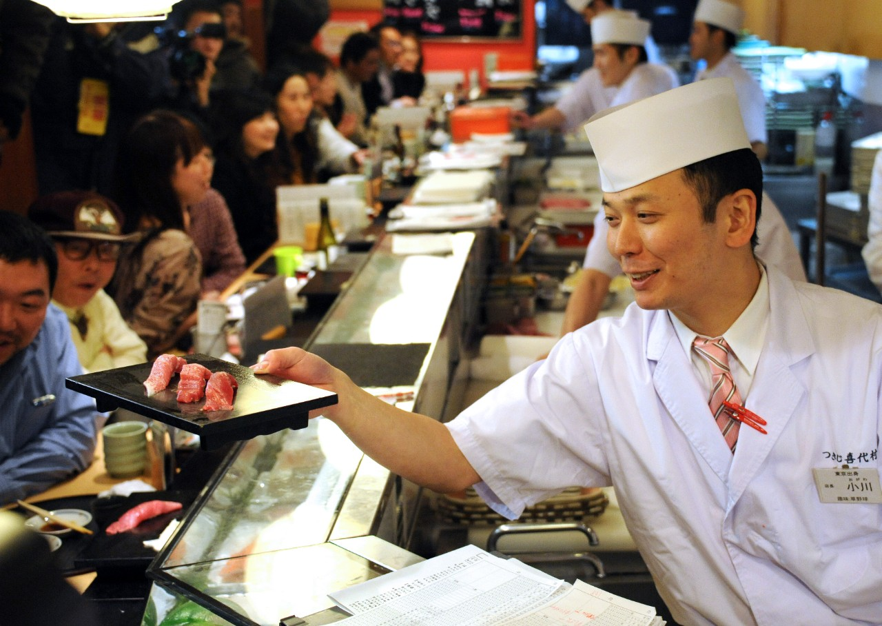
Next Project: future prospect: Japanese References/ Trenggalek Traditional food

Slide 23
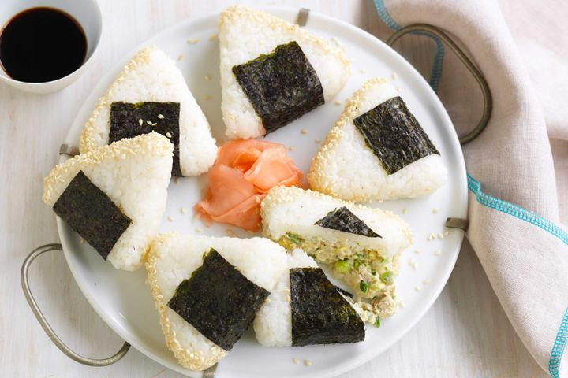
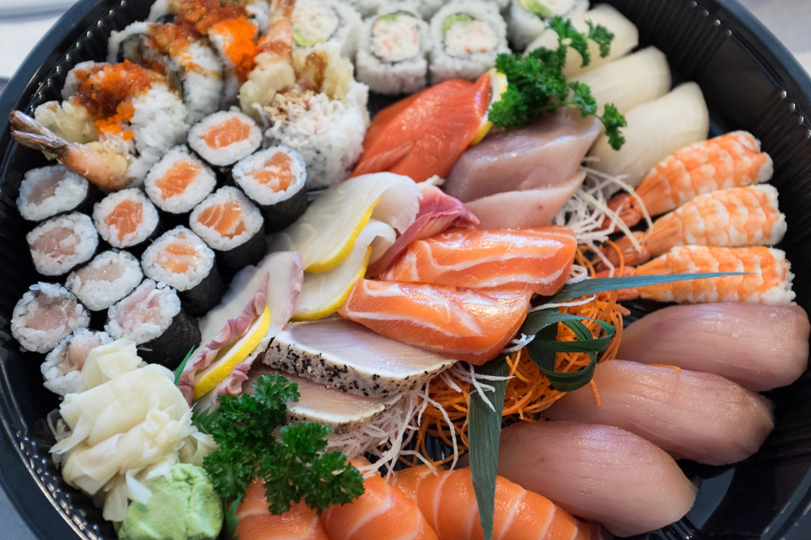
SUSHI
ONIGIRI

Slide 24
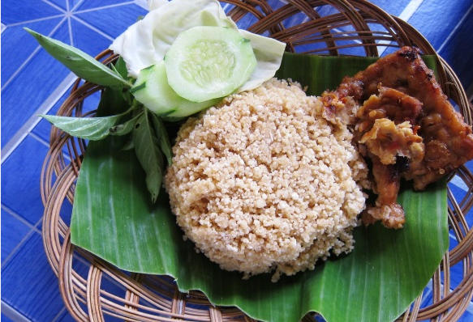
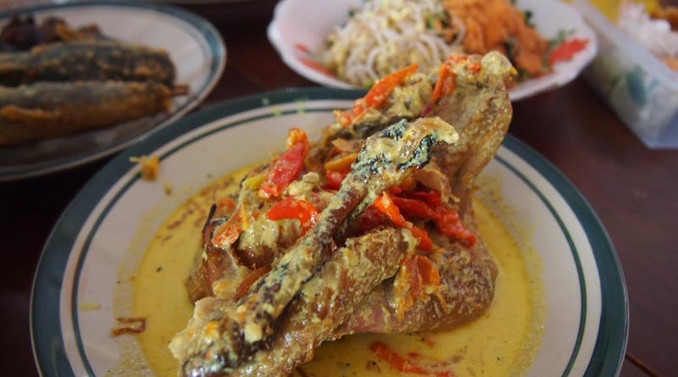
Nasi Gegok Trenggalek
LODHO Trenggalek

Slide 25
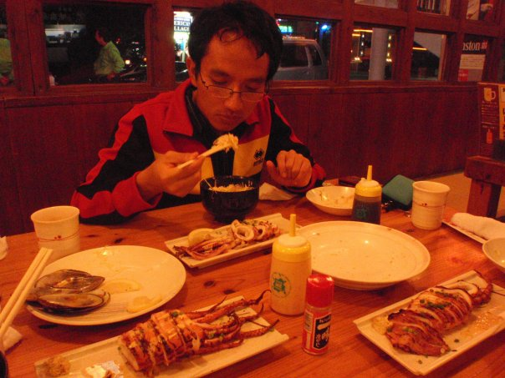
Thank You

