Slide 1
China’s Public Diplomacy in ASEAN: New Trends and Prospect in Indonesia One Asia Lecture Series 29 Nov. 2017 Universitas Negeri Malang University of Tsukuba Motoko Shuto

Slide 2
1. Introduction: definition of “Public Diplomacy” diplomacy by the state directly toward the general public abroad in order to improve and promote its positive images to pursue their own long-term strategic purposes
State State
State Agencies
(Hanban etc. )
Media Society
Local government
---------
NGOs

Slide 3
China’s Public Diplomacy in ASEAN Countries
JSPS FY 2013-2015
Introduction Motoko Shuto (University of Tsukuba)
Part I
1. China’s Public Diplomacy towards Southeast Asian Nations
2. Buying time rather than solving problems? China’s cultural exchange policy for ASEAN
Part II
3. China’s Public Diplomacy and Perceptions of China in Indonesia
4. China’s Public Diplomacy in Malaysia
5. Soft Power and China’s Public Diplomacy in the
Philippines: Keeping Politics at Bay
6. China’s Public Diplomacy through Confucius Institutes in Thailand
7. China’s Public Diplomacy in Cambodia
8. China’s Public Diplomacy in Vietnam

Slide 4
Research questions
(1) What are the major features of China’s public diplomacy toward Indonesia and other ASEAN countries?
⇒ Chinese language and traditional culture have been used as the distinctive features of China’s public diplomacy since the last decade
⇒ state policy to promote Cultural Industry (2017.10)
(2) What are the roles/commitment, if any, of local government, the media and local ethnic Chinese communities in the extra curricular activities?
(3) Is such expanding China’s public diplomacy working as China’s “soft power” ?

Slide 5
Literature review
On Chinese public diplomacy (PD)
1990s ~ the early 2000s: “Peaceful Development”
mid-2000s: “Assertive Public Diplomacy”
China has realized the importance of “soft power” in diplomacy in the four dimensions:
globalizing Chinese media,
promoting Chinese cultural industry,
promoting PD through overseas Chinese,
promoting think-tanks.
“China had been skillfully expanding its influences on developing countries through its “charm offensive” … .but “China’s charm cannot obscure the fact that it will think of its own interests first“ (Kurlantzick 2007, pp.274-276).
2012~, “Offensive Public Diplomacy” for a purpose of protecting “Chinese interest abroad.” (Aoyama 2007, p.438.)

Slide 6
critical comments on China’s Public diplomacy
“ nothing but a combination of pursuit of national interest with its organizational and traditional capacity of propaganda attached with advanced communication tools”
“it is state-centric diplomacy with rigidity and intolerance, such official culture is less attractive and less capable of impressing the others with positive images.”
(Nakai 2011, p.14.)

Slide 7
On “Soft Power” and the rise of China
J. Nye (2004) : 3 sources of soft power:
its culture (attractiveness to others)
its political values
its foreign policy (legitimate and moral authority)
Chinese media and scholars
traditional culture, its development model
soft power lies in the “soft use of power” to increase a state’s attraction, persuasiveness, and appeal (Li Mingjiang p.7. )
soft power in China’s public diplomacy focusing on Chinese image projection through CCTV International, Chinese government Spokesperson system, Huawei’s CSR
“China’s path of reclaiming international recognition and prestige” (Jian Wang, p.14. )

Slide 8
On Confucius Institute (CI)
“academic malware” (Sahlins, 2015, p. 61.)
Compared with the publications on CIs in the US, the empirical research on CIs in Asia is few.
Prof. Thung JuLan (LIPI)
Hartig focused on the unique organizational structure of the CIs in Australia and Germany, “the most prominent and most controversial instrument of Chinese public diplomacy.”
they are “not introducing the real China, but that they tend to present a politically correct version of China to the world”. (Hartig, 2016, p. 165.)

Slide 9
２．Background of the new trends
1) China
Promoting positive images to challenge against the “China threat” theory
Globalizing the Chinese media
Economic strategy
Promoting Cultural industry
2) ASEAN
The Framework Agreement on Comprehensive Economic Cooperation (Nov 2002) to establish the ASEAN-China FTA
China acceded to the TAC in October 2003.
The China-ASEAN Joint Declaration on Strategic Partnership for Peace and Prosperity, October 2003 in Bali, Indonesia.
The first and second Plans of Action to implement the Joint Declaration (POA)in 2010 and 2015, respectively. The third POA with a timeframe of 2016-2020

Slide 10
Table 1: Confucius Institutes and Classrooms in ASEAN countries (source: Confucius Institute Headquarters (Hanban) http://english.hanban.org/node_10971.htm
Country | Confucius Institutes | Confucius classrooms
Brunei | n.d. | n.d.
Cambodia | 1 | 3
Indonesia | 6 | 2
Laos | 1 | 1
Malaysia | 2 | 0
Myanmar | 0 | 3
Philippines | 4 | 3
Singapore | 1 | 2
Thailand | 15 | 20
Vietnam | 1 | 0

Slide 11
2-1: Indonesia after “Reformasi”
Democratization; acceptance of Chinese culture
A.Wahid Administration (1999.10～2001.7)
⇒ China as a counter-balancer
・to promote Chinese capital investment
1999.12. Official visit to China
2000.1. lift the 1967 Ban of Chinese language and Culture
5. Bilateral cooperation agreement
2001.1 Imlek sebagai hari libur fakultatif (Keppres No.6, 2000)
2002.3 Megawati, Official visit to China
2002.4 Chinese New Year as a National Holiday (2003)
& social organizations (see 2-1 below)
Economic relations

Slide 12
2-2．after the SBY Administration
(1) Strategic Partnership Agreement
Official visit to China (2005.7) bilateral agreements on: Trade, Defense technology
cooperation, Rehabilitation grant aid to Aceh
Tsunami disaster, Four Infrastructure Loan
agreements
Chinese Language Institutes
informal efforts
formal la efforts to set up CI
⇒ “Plan of Action for Strategic Partnership”
（2010.1～2014.12)

Slide 13
（2) Comprehensive Strategic Partnership （2013.10.2)
① Political, Defense, Security cooperation
② Economic, Trade cooperation
③ Maritime, Space, Science Technology cooperation
Joint Project for the Maritime Cooperation Fund
More than 15 Indonesian scientists invited to China
Joint Space Cooperation Committee
④ Social Cultural cooperation
100 youths/each exchange program in the 5 years
Media exchange, expansion of Public Diplomacy
Indonesia-China Seminar to be regularly held
⑤International, Regional Cooperation
Promote ASEAN-China Relations
Notes:
Rs

Slide 14
(3) Joint Statement on Strengthening Comprehensive Strategic Partnership between China and Indonesia
2015/03/27 http://www.fmprc.gov.cn/mfa_eng/wjdt_665385/2649_665393/t1249201.shtml
27. The two sides shared the view that youth is the future of bilateral relations, The two sides agreed to continue the annual 100 Youth Exchange Program. The Chinese side will continue to invite outstanding Indonesian youth representatives to participate in the ASEAN youth cadre training program.
28. The two sides agreed to enhance practical cooperation in student exchange, language education, higher education and vocational training under the framework of the relevant bilateral education cooperation agreements,
speed up the negotiations for the signing of the Agreement on the Mutual Recognition of Higher Education Degrees and Diplomas.
The Indonesian side commended the important role of Confucius Institutes in promoting the Chinese language.
The Chinese side welcomed the establishment of Indonesian Studies Centers in Beijing and Guangzhou.
The Indonesian side offered the Chinese participants to take part in the Indonesian Arts and Culture Scholarship program as well as in the Senior-Level Diplomatic Training in Indonesia.

Slide 15
(4) Culture in the power transition
In his speech on Oct. 18, 2017 at the National Congress of CCP, Xi said
China aims to realize socialist modernization by 2035 and turn into a fully developed nation -- a “global leader in terms of comprehensive national power and international influence” on par with the U.S. -- by 2049.
unveiled a more assertive regional and global role for China.
China's "flourishing" growth model under Communist rule has given "a new choice" to other developing countries and declared that the time has come for China to "take center stage in the world
https://asia.nikkei.com/Features/China-up-close/No-successor-needed-Xi-Jinping-s-dream-extends-to-2035?page=2

Slide 16
３. New trends through PBMs in Indonesia
Long-term strategic PD
the largest trade partner since 2013
Findings: the four out of the six PBMs
1) Process of opening
2) Management, networking
3) Contents of education
extra-curricular activities
4) relations with the local ethnic Chinese-
Indonesian associations/ business groups/media

Slide 17
Table 2: Indonesia’s major trade partners (US$100M) (source: compiled based on the Yearbooks by Institute of Development Economies(IDE), Japan)
 | 2004 | 2006 | 2008 | 2010 | 2011 | 2012 | 2013 | 2014 | 2015 | 2016
Export to PRC | 4,605 | 8,344 | 11,637 | 15,575 | 23,344 | 21,524 | 22,532 | 17,303 | 14,545 | 16,675
Japan | 15,962 | 21,732 | 27,744 | 25,487 | 32,495 | 28,969 | 26,439 | 20,809 | 17,152 | 15,653
ASEA N | 12,998 | 18,483 | 27,171 | 33,646 | 39,665 | 40,408 | 39,056 | 38,303 | 32,417 | 32,771
world | 71,585 | 100,799 | 137,020 | 158,074 | 200,788 | 188,146 | 183,548 | 175,293 | 148,341 | 144,441
Import from PRC | 4,101 | 6,637 | 15,247 | 20,661 | 26,198 | 29,486 | 29,822 | 30,631 | 29,363 | 30,682
from Japan | 6,082 | 5,516 | 15,128 | 16,785 | 19,374 | 22,675 | 19,199 | 16,867 | 13,256 | 12,983
ASEAN | 11,494 | 18,971 | 40,968 | 39,304 | 52,883 | 55,495 | 56,235 | 50,082 | 38,460 | 34,646
World | 46,525 | 61,066 | 129,197 | 135,323 | 176,201 | 190,225 | 187,369 | 168,310 | 135,060 | 129,051

Slide 18
Table 3 : PBMs and their partners in China (source: made by author)
Universities in Indonesia (City) | Partner universities in China | Open | Volunteers (as of 2015~2016)
Univ. Negeri Malang (Malang) | Guangxi Normal University | 2010. 8 | 7
Univ. Kristen Maranatha (Bandung) | Hebei Normal University | 2011.1 | ----
Univ. Hasannudin (Makassar) | Nanchang University | 2011.2 | ----
Univ. Negeri Surabaya (Surabaya) | Central China Normal University | 2011.5 | 4 *
Univ. Al Azhar Indonesia (Jakarta) | Fujian Normal University | 2011.11 | 9
Univ. Tanjungpura (Pontianak) | Guangxi University for Nationalities | 2011.11 | 7

Slide 19
1) Process of opening PBMs
It started in a top-down way by the center (Beijing), both at informal and formal channels initially, later at the G-G level.
It was Hanban that proposed counterpart universities, except UAI which had its own exchange program with FNU.
In the negotiations with Hanban to set up the PBM;
UNESA agreed to set up a Mandarin education program, which opened in September 2010
( Table 2, * in addition, 7 Indonesian teachers of Mandarin, 2 of
them are permanent. One of them got an MA degree with the
Hanban scholarship during 2011 and 2013)
The Mandarin education program (Prodi) Tanjungpura University started in 2009
The office of international relations UNSEA was established to prepare for the MOU with its partner university in Guangxi. the
UM, Jawa Pos Group (?)
Jurusan Sastra Jerman (JRM)
Program Stud S1 Pendidikan Bahasa Jerman
Program Stud S1 Pendidikan Bahasa Mandarin

Slide 20
2) Management, networking of PBMs
【Government】 【China 】
Hanban
Host University Partner
University
President of the University
PBM
Indonesian director Chinese Director
Chinese Study Program
Local professors Chinese teachers (“volunteers”)
courses & classes for other public institutions
traditional Chinese cultural events
The president and the two directors of the host university are expected to attend an annual CI conference.

Slide 21
Management and Networking
Controlled by the center (Hanban) institutionally and financially (1.5 billion rupiah /year), the daily task is primarily managed at the university level, including
Short-term (2 weeks) study trip
3 months intensive course in China
⇒ a unique combination of formal relations and informal networks at the transnational local level
Chinese volunteers cooperate for “designing syllabi and advising the department of Chinese studies”(UAI)
Chinese Director, primarily for administrative mission
Volunteers, mostly fresh from graduate school or graduate students of Master’s program for one year, to prepare for a thesis
they attend an intensive Hanban training for five-eight weeks and learned linguistics, education skills, Chinese culture, Indonesian language, etc.
They must submit a report to Hanban every 3 months on their daily activities, the physical condition of the class rooms, etc.

Slide 22
In Comparison with other ASEAN Countries
Confucius Institute at Royal Academy of Cambodia (CIRAC)
under direct supervision of the Council of Ministers of Cambodia, the most powerful agency in Cambodia.
Its branches have increased from one headquarter in 2009 to 25 in 2016. Each branch is located at local universities, schools or institutions as cooperating partners.
CIRAC has signed the MoU to establish CIRAC Chinese Language Training Class with the Cambodian Assembly and Senate.
CIRAC opened another branch at military school.
the number of students rapidly jumped to about 3,000, number of students enrolling CIRAC classes about ten thousand in 2015
CIRAC is providing scholarship to Cambodian students to study in China.
CIRAC uses many means of advertisement including multi-media, social network, and direct contact. The Chinese embassy launched a local radio station, “Cambodian-Chinese Friendship Radio”, and CIRAC is working with this radio to promote Chinese culture and CIRAC program.

Slide 23
3) Contents of Education provided by PBMs
40 - 50 student /year, Students from other courses, such as economics, take the Chinese as a second language. More than “one thousand students are now enrolled in courses coordinated by PBM,” as there are two options, English or Chinese, for a second language at UNTAN.
the traditional culture such as traditional dance, music, Chinese art, Tai Chi, Chinese cuisine, Chinese songs, and calligraphy. (practice of writing “Peace” ”I love China” etc. ).
No materials of the contemporary Chinese dramas, movies the four CIs Indonesia.
there is a large map of China in a room, and it simply clarifies the China’s claim of the South China Sea (Nine-dash Line).
In general, the major focus of Chinese cultural used for its public diplomacy is an ancient civilization, not a modern popular culture, and China emphasize that Chinese civilization is widely shared with Southeast Asia for centuries.

Slide 24
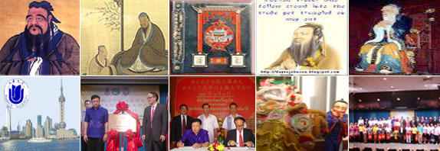
Confucius Institute at Phuket, Prince of Songkla University

Slide 25
Extra-curricular activities
actively committed with multi-purpose missions;
teach at other universities, teach for pilots, flight attendants, medical doctors, civil servants such as police officers, Indonesian Navy or Immigration officers (PBM-UNESA)
two private companies, which were the joint ventures of Chinese and Indonesian companies (Pontianak)
⇒ state institutions such as the Ministry of Defense, Defense university (Malaysia) , state agencies (Cambodia) , if they are asked.
⇒ ‘Confucius Institute of Maritime Silk Road’ at Dhurakij Pundit University inaugurated in 2015, more than 26 agencies have shown interest in establishing partnerships with the CI of Maritime Silk Road and a senior Buddhist monk greatly supported it.
Notes:
)

Slide 26
Social activities
The Mandarin education program of UNESA holds a Mandarin National Seminar every year since 2011, financially supported by Hanban .
⇒ Most topics relate to Chinese language education, but some topics are related to Chinese culture or literature.
The PBM in Surabaya has created new Chinese courses for students from University of Airlangga and University of 17 August 1945 .
There are 20 to 30 students in a class, and the total number of students from these two universities exceeds 300 to 340.
Premier Weng Jibao visited Jakarta in April 2011, he visited UAI
President Xi Jinping visited Jakarta in October 2013, students from UAI participated in an official welcome event
limited relations with the local Chinese- Indonesian associations / business groups/media ⇒ Ethnic Chinese nationals are not the main targets in the cases of Indonesia and Malaysia.

Slide 27
Merits of studying at PBM
there are two incentives for studying at PBM:
opportunity to study Chinese with native speakers
opportunity to obtain scholarships to study in China.
Application for the scholarships from Hanban,
recommendation from PBM is needed, particularly for one year or two-year master’s program
However, if there are other scholarship options for studying in China, applicants could cancel their PBM applications, as in the cases in Surabaya

Slide 28
limited interactive relations with the local ethnic Chinese-Indonesian associations / business groups/media
In West Kalimantan, the Chinese daily, Kun Dian Ri Bao, frequently covers the activities of PBM in Pontianak and in other areas of West Kalimantan, partly due to the personal relations between the President of the Chinese daily, Yosef Setiawan, and the PBM Indonesian director of UNTAN.
The Jawa Pos Group, including Jawa Pos Television, usually advertises PBM activities in Surabaya, often free of charge. The
PBM seems to cautiously avoid close relations with local Chinese organizations that appeal politically or explicitly Confucius identity.
One of such organizations in West Kalimantan, High Council on Confucianism (MATAKIN*) criticizies that the PBM has shown no interest in teaching Confucianism in the curriculum, making use of the name of Confucius
*Majelis Tinggi Agama Konfuchu Indonesia.

Slide 29
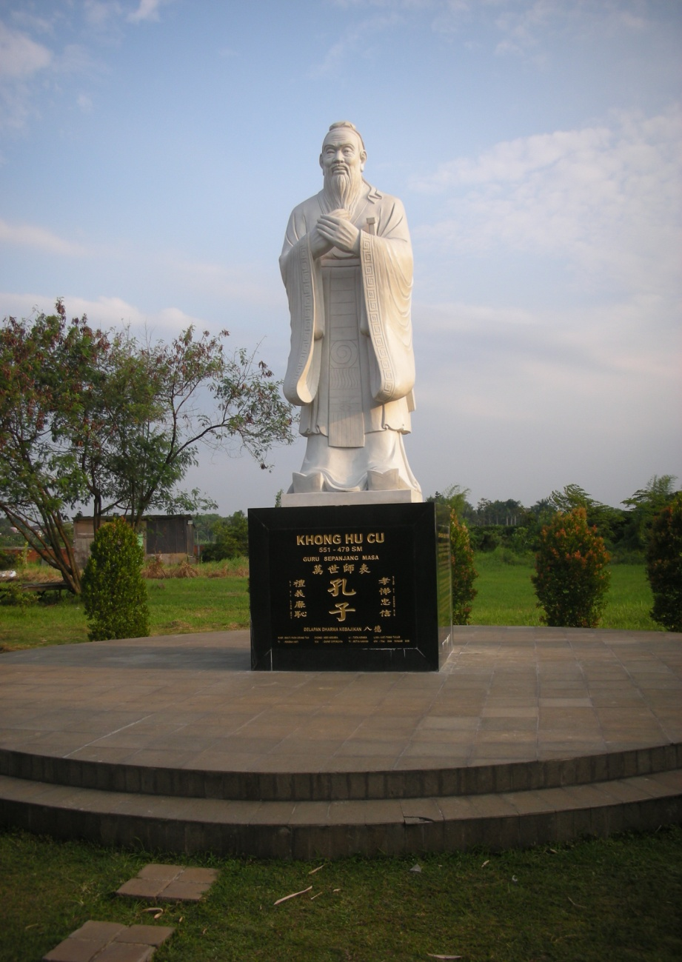
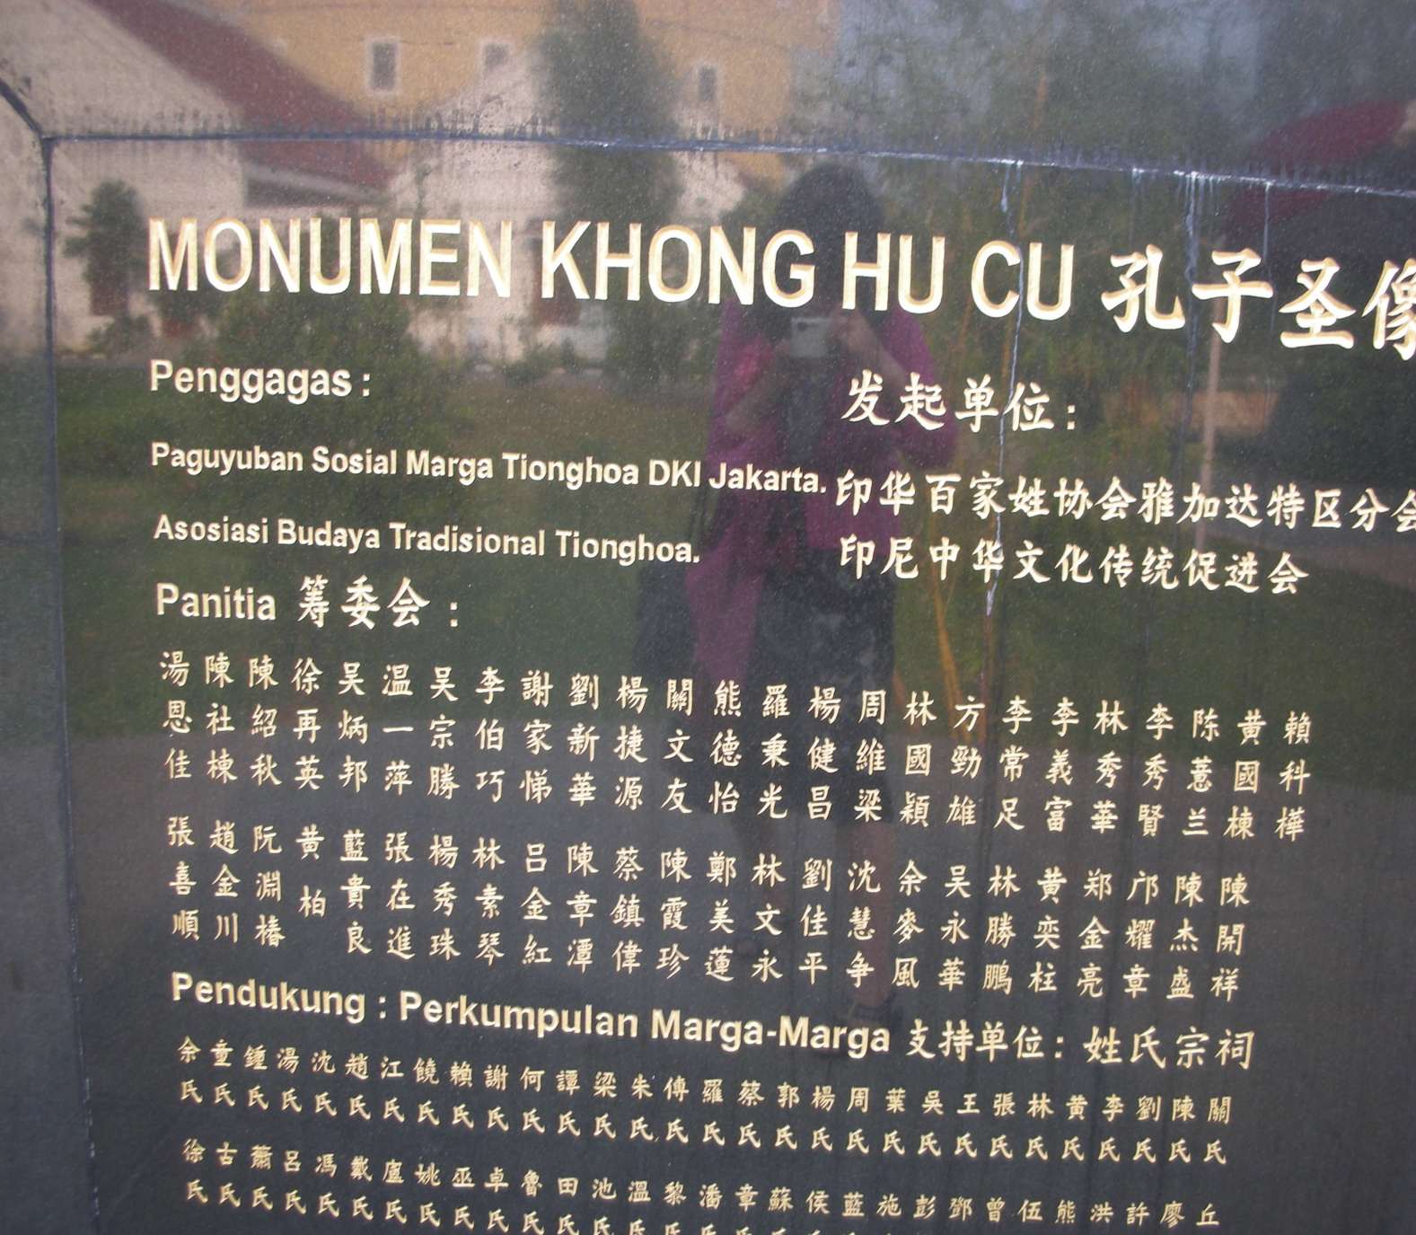
Taman Mini National Park
Chinese culture inside Indonesian society and scholarships through the nation-wide Chinese –Indonesian associations
Paguyuban Sosial Marga T.I (PSMTI)
1998. 9 . Branch offices in 30 provinces
INTI, 1999.4 19 branch offices
Pemuda INTI .
And other local private schools,private universities

Slide 30
Pusat Bahasa Mandarin UM, Gelar Pertujukan Kolosal Tiongkok Gemilang http://www.um.ac.id/content/page/2/2017/10/pusat-bahasa-mandarin-um-gelar-pertujukan-kolosal-tiongkok-gemilang

Slide 31
Direktur Pusat Bahasa Mandarin UM Prof. Dr. Yazid Basthomi, M.A.,
"Peringatan berdirinya Pusat Bahasa Mandarin UM ini menurut saya dapat menjadi momen bagi kita khususnya untuk dapat membandingkan dan belajar dari Negeri Tiongkok, dimana saat ini Tiongkok mampu menjadi negara besar dan diperhitungkan dalam segala lini. Kita harus mampu berwawasan comparatif terhadap Tiogkok agar dapat belajar mengembangkan menjadi negara besar yang maju,"ujarnya saat memberikan sambutan.
"Momen ini selayaknya dapat menjadi daya dorong bagi kita semua, khususnya generasi muda untuk merefleksikan diri terhadap praktek-praktek kebangsaan kita dengan komparasi negara Tiongkok yang memiliki ajaran Confusius dalam rangka membangun dan menguatkan wawasan kebangsaan kita bersama demi kemajuan masyarakat dan Bangsa Indonesia,"harapnya.
http://www.um.ac.id/content/page/2/2017/09/pusat-bahasa-mandarin-um-selenggarakan-confusius-institute-day-2017

Slide 32
4. Tentative Summary
(1) Can China’s public diplomacy work as China’s “soft power” ?
1) The Chinese classes and extracurricular cultural events of CIs are generally well-accepted particularly by the young generation.
Willingness to learn from China’s economic development
During the past several years only, graduates from PBM who studied in China the scholarship of China have returned to Indonesia to teach the Chinese at PBM
a change of perceptions toward Chinese Indonesians since the 2000s. It is widely held that discrimination against certain ethnic groups should not be allowed in Indonesian democracy
Generational change in Indonesia. The average age of the population is 28. Two of five people were brought up in the post-Suharto era, having no memory of discrimination against Chinese Indonesians during the Suharto era.

Slide 33
2) The major factor behind the positive views of PBMs is linguistic pragmatism for the purpose of future career development, not a normative value of soft power.
interest in Chinese culture which is selected and provided by CIs as part of Chinese “soft power” is limited but slightly increasing for the educated Indonesian young generation.
3) On the other side, it is difficult to evaluate its impacts, as
Chinese culture has been embedded in the local ethnic Chinese associations
They have promoted local cultural exchanges among the associations in provinces in China
Young Indonesians have many other options at the same time to learn English, Chinese or other foreign languages and to get access to various information though the ICT. ( comparative approach is possible for them through multiple approaches to information) , thus China’s public diplomacy remains to provide one of the means available for them
Therefore, the positive image of China may be affected if China keeps taking offensive stances contrary to national interests of the host countries

Slide 34
(2) China’s Public Diplomacy in the regional context of ASEAN
The primary target of CIs is, with an exception of Vietnam, the young educated and non-ethnic Chinese people in urban areas.
For them, CIs have provided opportunities to learn the Chinese language and traditional culture, and to experience a study seminar in China.
For the Chinese government, its long-term strategy of producing pro-Chinese future leaders in ASEAN countries.
It is unclear whether or not such young people are attracted by the “soft power “ of China’s public diplomacy, as they have an easy access to other sources of information through their communication tools.
CIs do not depend on the local ethnic Chinese communities in ASEAN countries, and local Chinese media do not always cover the extra-curricular activities.
⇒ unique exceptional cases, Cambodia and Vietnam

Slide 35
Major References
Barr, Michael, Who’s Afraid of China? The Challenge of Chinese Soft Power, London Zed Books,
2011.
D’Hooghe, Ingrid, “Public Diplomacy in the People’s Republic of China” in Mellissen, Jan ed., The
New Public Diplomacy Soft power in International Relations, New York: Palgrave
Macmillan, 2005, pp.88-105.
D’Hooghe, Ingrid The Rise of China’s Public Diplomacy, Hague: Clingendael,2007.
D’Hooghe, Ingrid, “The Expansion of China’s Public Diplomacy system” in Wang, Jian eds., Soft
Power in China: Public Diplomacy through Communication, New York Palgrave Macmillan,
2011, pp. 19-35.
Edney, Kingsley, The Globalization of Chinese Propaganda: International Power and Domestic
Political Cohesion, New York: Palgrave Macmillan, 2014.
Hartig,Falk, Chinese Public Diplomacy: The rise of the Confucius Institute, London and New York:
Routledge, 2016.
Lai Hongyi, “China’s cultural diplomacy: Going for soft power”, in Hongyi Lai and Yiyi Lu eds.,
China’s Soft Power and International Relations, Abingdon: Routledge, 2012, pp.83-103.
Kurlantzick, Joshua, ”China’s Charm Offensive in Southeast Asia” CURRENT HISTORY”,
September 2006, pp. 270-276.
Kurlantzick, Joshua, Charm Offensive: How China‘s Soft Power is Transforming the World New
Haven and London: Yale University Press, 2007.
Mellissen, Jan ed., The New Public diplomacy Soft power in International Relations, New York:
Palgrave Macmillan, 2005,
Li Mingjiang ed. Soft Power: Choina’s Emerging Strategy in International Politics, London:
Lexington Books, 2009.
Nye, Joseph S. , Soft Power : The Means to Success in World Politics, New York: Public Affairs,
2004.
Marshall Sahlins, Confucius Institutes: Academic Malware, Chicago: Prickly Paradigm Press,
2015.
Shambaugh, David, China goes global: partial power, New York: Oxford University Press, 2013,

Slide 36
Thung Ju Lan, “Confucius Institute at Al Azhar University, Jakarta: the unseen power of China”, paper presented at the 3rd workshop on China’s “Soft Power” in Southeast Asian, 4-5 August 2014, Manila.
Wang Jian ed. Soft Power in China: Public Diplomacy through Communication, New York: Palgrave Macmillan,2011.
Yan, Alan & Hsiao, Michael, Confucius Institutes and the Question of China’s Soft Power Diplomacy, China Brief, Vol.12, Issue 13, 2012.
Young Nam Cho and Jong Ho Jeong, “China’s Soft Power: Discussion Resources and Prospects. Asian Survey, vol.XLVIII, no.3, 2008, pp. 453-472,
Wang, Yiwei, “Public Diplomacy and the Rise of Chinese Soft Power,” The Annals of the American Academy of Political and Social Science, vol. 616, 2008,
Wang, Yiwei,“Relational Dimensions of a Chinese Model of Public Diplomacy”, Relational, Networked and Collaborative Approaches to Public Diplomacy: the Connective Mindshift, R.S. Zaharna, Amelia Arsenault, and Ali Fisher eds., New York & London, Routledge, 2013, pp. 86-99.
(in Japanese)
Aoyama Rumi. Diplomacy of Contemporary China, Keio University Press, 2007.
Aoyama Rumi, “China’s Public Diplomacy” in Shin Kawashima ed., China’s Diplomacy –Self-
identities and Problems , Yamakawa shuppan-sham , 2007, 35－54.
Yoshibumi Nakai, “China’s Public diplomacy: Critical review, Study report on China’s
Diplomacy, Japan Institute for International Affairs, March 2011.
www2.jiia.or.jp/pdf/resarch/h22_Chugoku_kenkyukai/02_Chapter2.pdf (last accessed
April 20, 2017)

